Slide 1


Home Building Skills Partnership
Brickwork Masterclass Programme Evaluation
Final Report
May 2022

Slide 2


Development of the brickwork masterclasses
About the Home Building Skills Partnership and the brickwork masterclasses
The Home Building Skills Partnership (HBSP) was set up by the Home Builders Federation in 2016 (initially funded by CITB) and is a collaboration of home builders and supply chain organisations working together to attract and develop the workforce of the future and in doing so change the culture of the home building sector.
The HBSP team leads on and supports work to help tackle skills gaps and shortages and ensure sufficient capacity within the workforce to deliver the supply of good quality new homes the country needs.
Why were the brickwork masterclasses developed?
Growing need for bricklayers, but skills shortage persists
HBSP research highlighted need to tackle common site defects
The current level of skilled bricklayers in the UK is almost a quarter of the size needed to meet government targets for building new homes. The 2018 Letwin review estimated a need for 15,000 more trained bricklayers by 2023.¹
In 2020, the Home Office rejected a recommendation by the Migration Advisory Committee (MAC) that bricklayers be added to the Shortage Occupation List choosing instead to wait and assess the impact of both the coronavirus and the new immigration rules.
Demand far outstrips supply, but this is not the only concern. Main contractors report difficulties finding bricklayers who are sufficiently skilled. Employers have questioned whether Further Education (FE) training equips learners with the requisite practical and work readiness skills and knowledge.
HBSP research drew upon warranty provider quality data from Premier and NHBC and identified the most frequent defects year-on-year: DPCs and trays, cavities, weep holes and insulation, fire stopping and sound proofing. The brickwork masterclasses were designed specifically to tackle these issues and build learning around them into the curriculum. The intervention is funded by CITB.
The brickwork masterclass programme aims to raise awareness of common issues and defects and provide guidance as to best practice to raise standards. The dual objective is to change behaviours thus contributing to the eradication of common defects on home building sites and warranty claims arising as a result.
Notes:
1 Independent review of build out: draft analysis https://www.gov.uk/government/publications/independent-review-of-build-out-draft-analysis

Slide 3
Background to the evaluation
Brickwork Masterclass Programme overview
HBSP, NHBC and the Association of Brickwork Contractors (ABC) developed in conjunction with industry the initial brickwork masterclasses delivered on-site to bricklayers and at college venues for FE tutors, in the form of three main programmes:
90-minute upskilling programme delivered on-site to bricklayers (subsequently further developed with additional funding into a 4-hour blended learning approach that included additional video content and reading material, aiming to enable a sustainable, long-term solution
Half-day Continuing Professional Development (CPD) for FE tutors
3-day and 1-day defects prevention programmes for Site Managers, Assistant Site Managers, Engineers and Quantity Surveyors (out of scope for this evaluation)
About this report
This independent evaluation of the brickwork masterclass programme was commissioned to assess its impact and effectiveness. This report brings together the findings in relation to the delivery of:
Brickwork masterclasses held in Further Education establishments, attended by college tutors and assessors and on occasions employers
Brickwork masterclasses held on home building sites during the period November 2019 to April 2022.
Findings from all research activity has been synthesised, combined and included in this report.

Slide 4
The need for the brickwork masterclasses
Occupation overview
The housebuilding industry is a major employer in the UK, with an estimated 800,000 people directly or indirectly supported by the planning, design and delivery of new homes¹. According to NOMIS annual population data, there are c60,900 bricklayers working in the UK².
The conservative government manifesto pledged to build 300,000 new homes each year by mid 2020s³ and whilst at least a proportion of these are likely to be built using Modern Methods of Construction, the demand for brick and block will inevitably increase, thereby increasing the demand for skilled bricklayers.
Skills shortages and impacts
Skills shortages within the construction industry have been well documented. In 2021, 41% of Federation of Master Builders (FMB) members stated that they are finding it difficult to hire bricklayers⁴, similarly Construction Industry Training Board (CITB) research found bricklaying vacancies among the top 5 hardest to fill.⁵
Taking on apprentices is critical to addressing these skills shortages, and recent construction employer research suggests a slight increasing trend in the number of apprentices within construction⁶. This is supported by national apprenticeship start statistics specific to bricklaying:
2018/9 | 2019/20 | 2020/21 | 2021/2
540 | 1,370 | 2,250 | 2,560*
Data source: GOV.UK Apprenticeships and traineeships data
* Provisional figure which covers the first two quarters (Aug 2021 to Jan 2022)
Notes:
1 https://www.hbf.co.uk/news/planning-materials-and-labour-shortages-threaten-housing-delivery-over-next-12-months/
2 Nomis Annual Population data Jan 21-Dec 21 Available at: https://www.nomisweb.co.uk/datasets/aps168/reports/employment-by-occupation?compare=K02000001)
3 https://www.gov.uk/government/news/government-announces-new-housing-measures
4 https://www.fmb.org.uk/resource/state-of-trade-survey-q4-2021.html
5 CITB Skills and Training Report 2021 https://www.citb.co.uk/about-citb/construction-industry-research-reports/search-our-construction-industry-research-reports/skills-and-training-in-the-construction-industry-2021/
6 CITB Skills and Training Report 2021 https://www.citb.co.uk/about-citb/construction-industry-research-reports/search-our-construction-industry-research-reports/skills-and-training-in-the-construction-industry-2021/

Slide 5
Evaluation methodology
Summary of the methodology
Process workshop held with key members of the project team
97
Depth telephone interviews with Site Managers and FE Tutors
Analysis of national CQR data
Review of site specific CQR reports pre- and post- brickwork masterclass*
Analysis of Post-on-site brickwork masterclass feedback survey (administered by NHBC)
Analysis of Post-FE face-to-face brickwork masterclass feedback survey
Methodological commentary
Due to the transient nature of the brickwork workforce, qualitative research focused on obtaining the views and experiences at a site manager level. Site managers were well placed to provide views of the impact of the programme on brickworkers and at a broader, organisational level.
Where it has been possible to include data in relation to longer term impacts (i.e. where quality review data is available at site level – noting inspections have a broader purpose) this has been included in the analysis.
Synthesis of all data and reporting
*Construction Quality Review reports were obtained for sites which held brickwork masterclasses with permissions from the participant organisation. Not all sites, holding brickwork masterclasses, are subject to a CQR

Slide 6
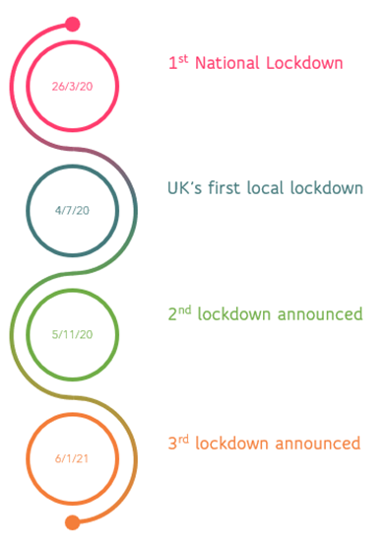
The impact of Covid-19 on the delivery of the brickwork masterclasses
Overview
Since the project commenced, the global pandemic Covid-19 has had a severe and immediate impact on the construction sector, the wider economy and society. As of 16th March 2020, NHBC was compelled to postpone all scheduled training either on-site or at FE colleges. Shortly afterwards, the UK entered a phase of lockdown, closing colleges and many construction sites. Timescales on the project have been extended as a result and the delivery of on-site brickwork masterclasses will continue into July 2022.
On-site brickwork masterclass attendance
A proportion of the brickwork masterclasses have been held during the later stages of the Covid-19 pandemic and the emergence of numerous variants with varied, and in some cases higher, levels of transmission.
Attendance numbers have been impacted by the need to socially distance; the space available to hold the sessions in light of social distancing needs; and fluctuating attendance where people were compelled to self-isolate.
The number of delegates per session has varied, with as many as 16 delegates in attendance; the average number of delegates is 9.

Slide 7
Key brickwork masterclass programme statistics
Delivery aims and achievements as at end of April 2022 – NOTE at this point the contract has another 3 months to run
 | Delivery target to 31 July 2022 |  | Delivery achievement as at 30 April 2022 |  | Comments
 | Masterclasses | Delegates | Masterclasses | Delegates
Brickwork masterclasses for FE Lecturers | 25 | 250 | 25* | 203* | In total 71 FE colleges were reached. When delivery switched to virtual, attendance reduced linked to lecturers dealing with Covid-19 related challenges in colleges and lockdown(s) imposed on the UK. At the conclusion of the evaluation of the FE element (June 2020), the masterclass target (25) had been achieved.
On-site brickwork masterclasses | 928 | 9064 | 825** | 7211** | Delivery target is a combined target of pre- and post- Covid-19 funding and delivery. N.B. The funding and delivery of the programme stopped in March 2020 due to Covid-19. The contract was re-negotiated and delivery recommenced September 2021. Initially masterclasses were slow to get going due to continued restrictions and social distancing. Numbers attending each masterclass have continued to remain slightly lower than the predicted 10/12 in a site cabin, latterly, this has been around 8/9 due to social distancing. At the conclusion of the evaluation (with 3 months left of the contract to run), 825 masterclasses had been delivered.
* Delivered between June 2019 and mid-March 2020
** Delivered between January 2019 to April 2022

Slide 8

Findings from face-to-face FE brickwork masterclasses

Slide 9
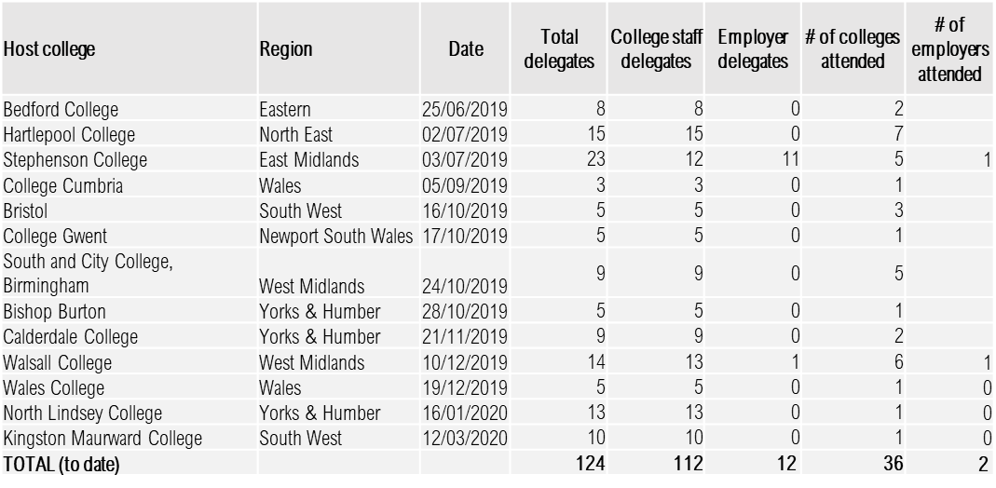
FE face-to-face brickwork masterclass statistics
124 delegates have attended brickwork masterclasses held face to face at FE colleges (Table 1). 12 of these delegates were employers (site managers and bricklayers) who were unable to attend on-site brickwork masterclasses, and thus came to a college venue instead. Although this was unplanned, it had a beneficial outcome of bringing representatives from education and industry together.
Of the 124 FE face to face brickwork masterclass delegates, just over 50% (64 respondents) completed a survey providing feedback, and telephone depth interviews took place with a fifth of delegates (27).
Impact and effectiveness have been assessed against four main indicators:
  Increased effectiveness/quality of FE curriculum content
  Increased knowledge of FE trainers and assessors
  Number of brickwork masterclasses delivered
  Delegate satisfaction
Table 1: Further Education face-to-face brickwork masterclasses and attendees to mid-March 2020

Slide 10

Key findings – FE face-to-face brickwork masterclasses
85%
Say the brickwork masterclass updated their knowledge for teaching
94%
Plan to make, or have made changes to teaching as a result
Very valuable content we’ve not seen anywhere else
83%
Have already put changes in place
87%
Believe changes to teaching are very or totally sustainable
This wasn't 'just another course', it was genuinely useful and focused on raising standards. In FE we are years behind what industry wants. We need to get the front line (tutors) upskilled and prepared to teach what industry wants
100%
Say the length, breadth and depth of the content was about right
96%
Would recommend the brickwork masterclass to a colleague
N.B. All statistics report survey data from 64 respondents

Slide 11
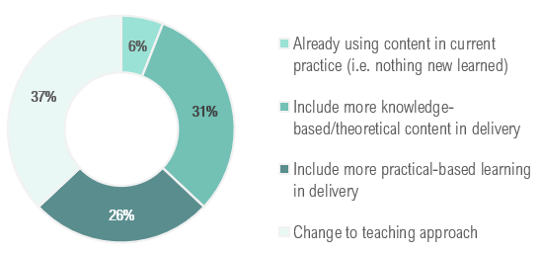
Use and impact of the FE face-to-face brickwork masterclasses
How, if at all, will you use what you learned?
37% of delegates surveyed either plan to or already have changed their teaching approach after attending the brickwork masterclass.
26% will include more practical learning, such as a greater focus in the workshop on precision of measurements and quality checking.
31% will incorporate more knowledge and information to share with learners – notably common types of defects experienced on-site and the wide-ranging impacts: costs incurred to rectify problems, risk of reputational damage as a bricklayer, and quality concerns of consumers buying new homes.
It did update my knowledge a lot, yes - I've been in the trade a long time and you forget things
To what extent did the training update your knowledge for teaching brickwork?
I still actively work as a joiner so keep abreast of building regs and so on - others probably learned a bit more than I did. Tutors are mainly in classrooms - for those people something like this is invaluable
85% of delegates say the brickwork masterclass updated their knowledge. Several delegates welcomed the fact that seminars like this can be counted towards CPD hours.
The 15% of delegates who said the brickwork masterclass did not update their knowledge at all, had all been in the trade for 20 years+, had been teaching for over 10 years and have regular opportunities to engage with employers on-site. These delegates found the brickwork masterclass interesting but suggested the content would be far more useful to less experienced tutors/assessors, particularly if they do not interact regularly with industry. Some delegates acknowledged they have lengthy trade experience gained over many years, but that they still learned new information from the brickwork masterclass.
N.B. All statistics report survey data from 64 respondents

Slide 12
Implementing changes in FE arising from the face-to-face brickwork masterclasses
Have you already put changes in place?
How sustainable are the changes?
We put changes in place straight away – we updated drawings and notes for the training for learners which we hadn't realised were out of date
83% of delegates surveyed have already implemented changes, and 87% consider these changes to be very or totally sustainable. Even in the context of the pandemic, only 10% say they are unable to put any changes at all into place until the new academic year. 69% of delegates have shared what they learned with colleagues and have continued to communicate good practice internally and externally.
Did you experience any difficulties putting changes in place?
I shared the information very easily with the learners, pulled resources into lessons - just slotted in a slide and had a quick discussion about it. The true cost of mistakes came as a shock to them. They seem more conscious of the quality of their work now
N.B. All statistics report survey data from 64 respondents

Slide 13
How the impact and value of the brickwork masterclasses can be enhanced – FE
Delegates are extremely positive about the length, content, and relevance of the brickwork masterclasses. Several suggested CPD certification could be shared at the end
Around a third of surveyed delegates raised concerns about the core FE curriculum content after attending, stating that not everything on the syllabus appears directly relevant for what employers want on-site
FE tutors expressed a strong desire for change in the FE curriculum for it to directly align with employer needs - otherwise a perceived disconnect between education and industry will persist - and potentially worsen
Around a third of the delegates interviewed suggest the brickwork masterclasses should also be offered to tutors and assessors in other construction trades (notably plastering, painting & decorating and carpentry & joinery) and multi-skills
Delegates attending brickwork masterclasses where employers were present, emphasised the value of having the ‘site perspective’ to provide valuable context and inform the debate. Several delegates suggest future brickwork masterclasses should be attended by a mix of FE staff and employers as well as awarding bodies - in their guise as the bodies setting the standards and defining the curriculum
Many delegates independently praised the style of delivery, and the interactive structure. Over a half-day, this is deemed an optimum length of time to keep the delivery engaging and allow time for networking with other attendees. However, several delegates pointed out that with travel time, the seminar was effectively a full day out
Nearly all delegates interviewed strongly agree that the seminar could be delivered just as effectively online – which would eliminate travel time while still giving attendees chance to interact and ask questions via virtual platforms
One delegate said a shift to online would be particularly welcome in the current climate, as some tutors are struggling to find fresh content to share with learners at home during lockdown
The content was absolutely relevant for trainers. It was interesting as an employer, to hear from the FE tutors what they are teaching learners. On the back of it, we invited the tutors to visit us on-site and get a better insight into processes and practices. They learned some of the content they teach is archaic and not relevant for industry. Some must be taught regardless, as it is in the curriculum, but tutors will give it less emphasis and focus more on the site-specific information. Tutors have been able to better prepare students for the real world. All very positive
This is a great opportunity to share with other trades tutors. A lot of us teach multi-skilling so we're expert in one trade, with a working knowledge of the others. It would be good for us to explain to learners how the trades interact on-site, how poor-quality work has an impact on all trades. We need more like this - and for all trades, not just brickwork. It would be good to renew the session and repeat it every year
It would be good to involve awarding bodies to incorporate this best practice into future qualifications. There's a real disconnect between what we teach and what employers want on-site

Slide 14
Findings from on-site brickwork masterclasses

Slide 15
On-site brickwork masterclass statistics
On completion of the on-site brickwork masterclasses, Site Managers (SMs) were asked to provide feedback via a survey. 290 SMs responded to the survey* and each was asked to rate four aspects of the brickwork masterclass using a rating scale of 1-5.
Perceptions were highly positive, most ratings were either 5 (excellent) or 4 (very good).
Average ratings:
Overall
4.92
Quality and Content
4.91
Trainer Effectiveness
4.94
Objectives met?
4.92
(Ratings based on survey responses from 290 site managers)
Notes:
*between November 2019 to April 2022.

Slide 16
Key findings: on-site brickwork masterclasses make a difference
Quality of delivery
The delivery of the brickwork masterclasses by NHBC inspectors was felt to be a key factor in their success. SMs and attendees greatly value their knowledge and experience. In addition, an understanding of their role and influence as an inspector garners respect and a sense that the information imparted is credible, accurate and, when followed will lead to adherence to NHBC requirements.
SMs perceive the Q&A session to be of high value to attendees; such sessions were particularly useful in finding absolute guidance on specific site issues. It was felt that the Q&A session offered greater benefit to more experienced attendees who already have a strong baseline knowledge and have queries with more advanced areas of the work.
Impacts reported
SMs report improvement in the quality of work undertaken post-brickwork masterclass, specifically:
    - Placement of vents - Cavity step trays
    - Firestopping - Keeping cavities clean
    - Slip ties - Internal pointing
    - Cavity ties
An increase in manager/supervisor knowledge was also reported which was thought to lead to increased competence in their role and their capability to manage the standards of bricklayers. SMs noted that in many cases the brickwork masterclass is likely to be have been the only external training some bricklayers’ will have received since completing their apprenticeship. As such, attendance would likely lead to an improved sense of value. Where improvements have been identified in bricklayers' attention-to-detail post-brickwork masterclass, SMs most commonly feel this is as a result of understanding WHY things must be done in a certain way. In the past it is likely that bricklayers are simply told to do something in a certain way, however, a lack of understanding of WHY brings complacency and an unwillingness to change.
Actions as a result of brickwork masterclasses
The nature and complexity of actions post-brickwork masterclass has varied widely. At a basic level, brickwork masterclass handouts have been included in induction information for new bricklayers arriving on-site. One site has developed and introduced a specialist checklist based on the NHBC guidelines. In some instances, there have been changes to the way supervisors and site management manage the standards of bricklayers. As a direct result of positive SM feedback, some organisations have arranged additional brickwork masterclasses on their other sites. One site has changed the specification in relation to preform lead trays, which is more costly but irradicates the issues they were previously experiencing. More generally, SMs have indicated they are more open to arranging training generally as a result of their positive experiences of the brickwork masterclasses.
I’ve seen a difference in their behaviour and quality of their work
It has helped them to improve themselves - instead of just being told to do something, they now know WHY it must be done

Slide 17
Site manager views of the on-site brickwork masterclasses
NHBC course trainers
Those delivering the on-site brickwork masterclasses were viewed as highly knowledgeable in terms of both quality/defect statistics and the practical aspects of brickwork. The trainers were skilful in engaging the attendees at all levels from apprentice to highly experienced. Brickwork masterclasses gained credibility through NHBC endorsement. Where brickwork masterclasses were delivered by the site's regular NHBC inspector this enabled them to tailor the content and delivery of the brickwork masterclass to the site which was felt to be highly beneficial.
Brickwork masterclasses were well received
Engagement levels were felt to be generally high. Bricklayers working on a sub-contractor basis were on occasion resistant to attending ("time is money") however, SMs felt this was largely overcome due to the knowledge of the trainer and relevance and quality of the brickwork masterclass content. Less experienced bricklayers were generally thought to better engage as a result of their more recent experience of structured learning, however, more experienced bricklayers engaged in and benefited from healthy debate with the trainer over NHBC requirements. SMs felt it was good for bricklayers to hear it from someone other than the site management.
The content was informative and backed up with statistics which helped to ensure ‘buy-in’ from attendees and the fact that the content included WHY something had to be done was felt to cover new ground, empowering bricklayers through this newfound knowledge and understanding.
Valuable, accessible learning opportunity
Face to face, interactive delivery is felt to work well. Visual examples and verbal delivery play to the strengths of the workforce. The informality of the brickwork masterclasses encouraged involvement from the workforce, enabling them to ‘steer their learning’ to a certain degree. The format was thought to be a good method of keeping bricklayers up to date with their craft and the standards required of them.
I had our apprentices on it who learnt a lot and the more established guys had a healthy debate with the trainer/inspector over NHBC requirements
They started to care they are actually building someone's home. We try internally to educate but coming from the NHBC inspector seemed to have more clout

Slide 18
Delivery and structure of on-site brickwork masterclasses
The process of arranging brickwork masterclasses and obtaining feedback from SMs has been refined during programme delivery. During the first lockdown period, organisations were encouraged to find out more about the brickwork masterclasses by completing a webform, enabling follow-up once the programme recommenced. Once the programme did recommence, organisations also had access to book a brickwork masterclass online via the NHBC website. This online approach has also increased the accuracy of contact information recorded and streamlined the administrative side of the process.
Initially SM feedback was gathered using a paper-based form. Latterly, feedback has been obtained through an online survey approach. Initially, it was challenging to obtain feedback from SMs through the online method, however, persistence of the NHBC team in pursuing this feedback made a difference, with feedback ultimately obtained from 290 SMs.
We had a great space to hold the MC and we had bricklayers from other sites from our subcontractors attending too which was good
Delivery method
On-site delivery was supported by SMs who state that this minimises time lost on the tools and removes geographical barriers. Face-to-face delivery is also thought to suit any attendees with literacy issues.
Content and structure
The breadth of content of the brickwork masterclass was felt to be particularly beneficial for less experienced bricklayers. The Q&A session was perceived to add significant value, giving the opportunity for the bricklayers to fill knowledge gaps and ask site-specific questions.
Timings and attendance
Brickwork masterclasses ran smoothly and on schedule. Numbers of delegates attending each brickwork masterclass were largely as expected by SMs. In some instances, bricklayers from the housebuilders other sites travelled to attend sessions and some sessions were also attended by managers and supervisors.
The length of the brickwork masterclass was felt to be right in terms of content and appropriate to hold the attention of attendees. Some suggest shortening the session slightly to improve engagement.
Attendance tracking
It is noted by SMs that there is currently no method of tracking bricklayer attendance. A few have their own method of recording this information internally.
The bricklayers asked loads of questions which I think they got the most from and, as the guy running it was the NHBC inspector, he had their respect
When new [bricklayers] come onto site we don’t have any way of knowing whether they have done a masterclass before

Slide 19
Knowledge gained
Bricklayers gained new knowledge, particularly those who were less experienced. Management and supervisors (not from a trade background) also gained knowledge. Knowledge gained was two-fold: that of ways of working and, a broader understanding of WHY certain tasks must be done in a certain way.
Impacts (1)
A range of impacts were experienced and identified through the evaluation; these are contributory factors in the reduction of the number of defects occurring:
Quality of craft
Through new-found knowledge of requirements, an understanding of the reasoning behind those requirements and updated skills, bricklayers improved the quality of their craft.
Morale and behaviour
bricklayers exhibit greater pride in their work and their working environment having gained awareness of the bigger picture – that they are contributing to the building of someone’s home.
Reduction in the number of defects occurring
Knowledge sharing
Post-brickwork masterclass, the process of sharing knowledge is ad-hoc. Most commonly, handouts are shared with those new to site. Knowledge is also shared verbally and spreads to other sites. Brickwork masterclass content has been included in learning and training development documentation at an organisational level.
Management capability
Increased supervisor and manager knowledge has led to tighter management with an increased ability to identify and mitigate potential quality issues.

Slide 20

Impacts (2)
All Site Managers surveyed reported a positive impact from the brickwork masterclass
People on-site are still talking about the masterclass [held November 2019] - the site managers were in a meeting just the other day and they were referring to info which they gained in the MC
The original leaflets that were given out are still on-site and available to look at
Our supervisors attended and have rolled out the content to their teams and to new people as they join if it is needed. We also copied all the information and gave that to all the bricklayers who attended
Reportable items went down as a result of the training
Really good, I only have positive feedback - we won an HBC award the year after we did the brickwork masterclass and I do think it was at least in part down to the masterclass
Behaviour has improved, they take more pride in their work and in the site generally - they clean the scaffold now and turn the boards over as was suggested to keep them dry too.
It had a little bit of an impact - our CQR rating has gone up since it was held
Biggest reflection of it's success so far I think is that they discussed it afterwards and still refer back to it now so it has stuck - the MC itself created debate during it and provided the clarity that is needed
Knowledge has increased - and certainly initially they were more motivated. I think the more time passes the more they lose focus and perhaps lapse into old ways but, I do think at least some of it has stuck with them

Slide 21


National Construction Quality Review Data

Slide 22
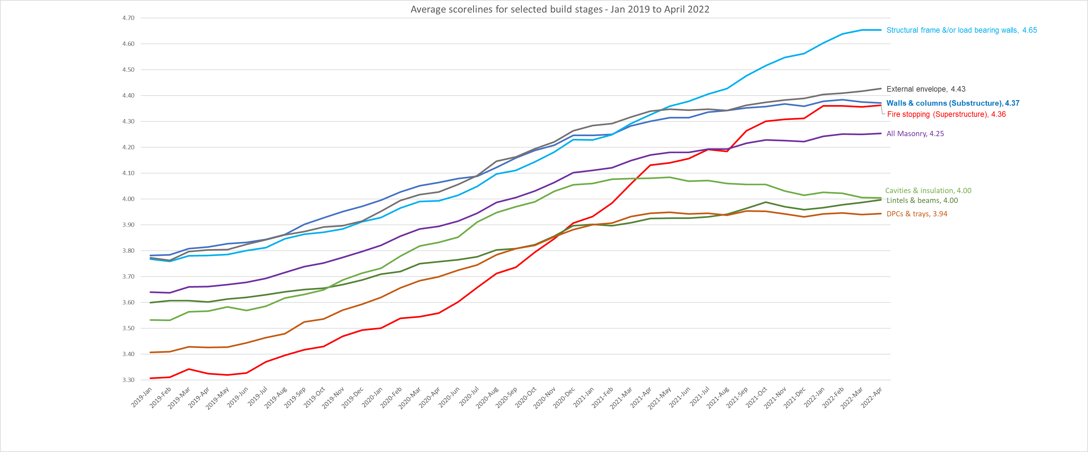
National NHBC CQR data (1)
National NHBC CQR data indicates an upwards trend in the quality achieved in those areas most closely aligned to brickwork as can be seen in the graph below. The measurement scale is 1 to 6 with 1 being very poor and 6 being exceptional:
N.B It should be noted that the upward trend in the data cannot be solely apportioned to the brickwork masterclasses. Additional initiatives at a national, local and organisational level are likely to have also had an impact on the results.

Slide 23
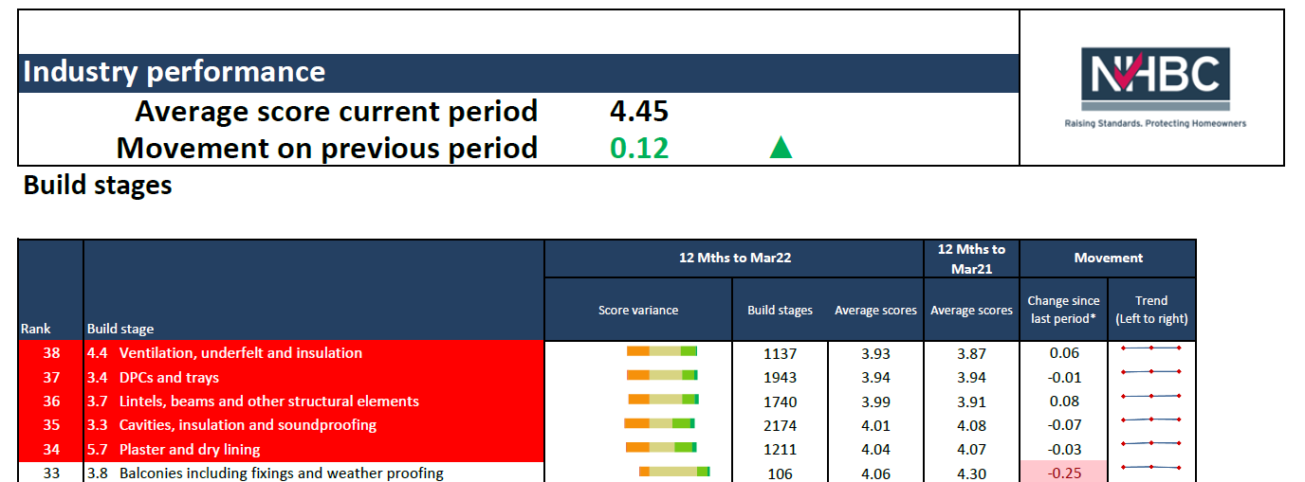
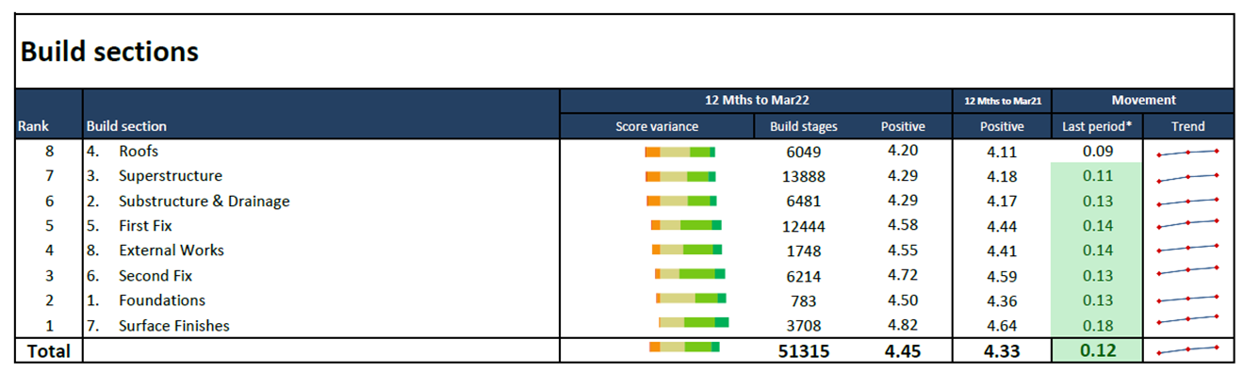
National NHBC CQR data (2)
National CQR data indicates an upward trajectory across all areas, including brickwork, however, brickwork continues to appear in three of the top five quality issues:
The superstructure elements of a build rank 7th out of the 8 categories, just behind roofs.
*any movement of 0.1 is highlighted

Slide 24

Case studies

Slide 25

Case studies
The following pages detail four site case studies which include extracts from site Construction Quality Reviews.
Case study 1 - overview
Context
Bricklayers on-site are a mix of subcontract gang and directly employed. All attended the brickwork masterclass and engaged which was visible through their listening and questioning. The bricklayers benefited greatly from being able to ask questions specific to the site.
Outcome and impact
The SM has seen an improvement in knowledge, especially in terms of the pointing up on ties inside (right depth and width). General behaviour has also improved, they take more pride in their work and in the site generally. They now clean the scaffold and turn the boards over as was suggested to keep them dry.
Their increased knowledge has improved the quality of their work. This is evident as the SM has noticed a decrease in the number of issues on-site, defects are believed to have reduced. This improvement has also had an impact on the SM workload.
The SM would very much recommend the brickwork masterclasses to others as “it works”.

Slide 26


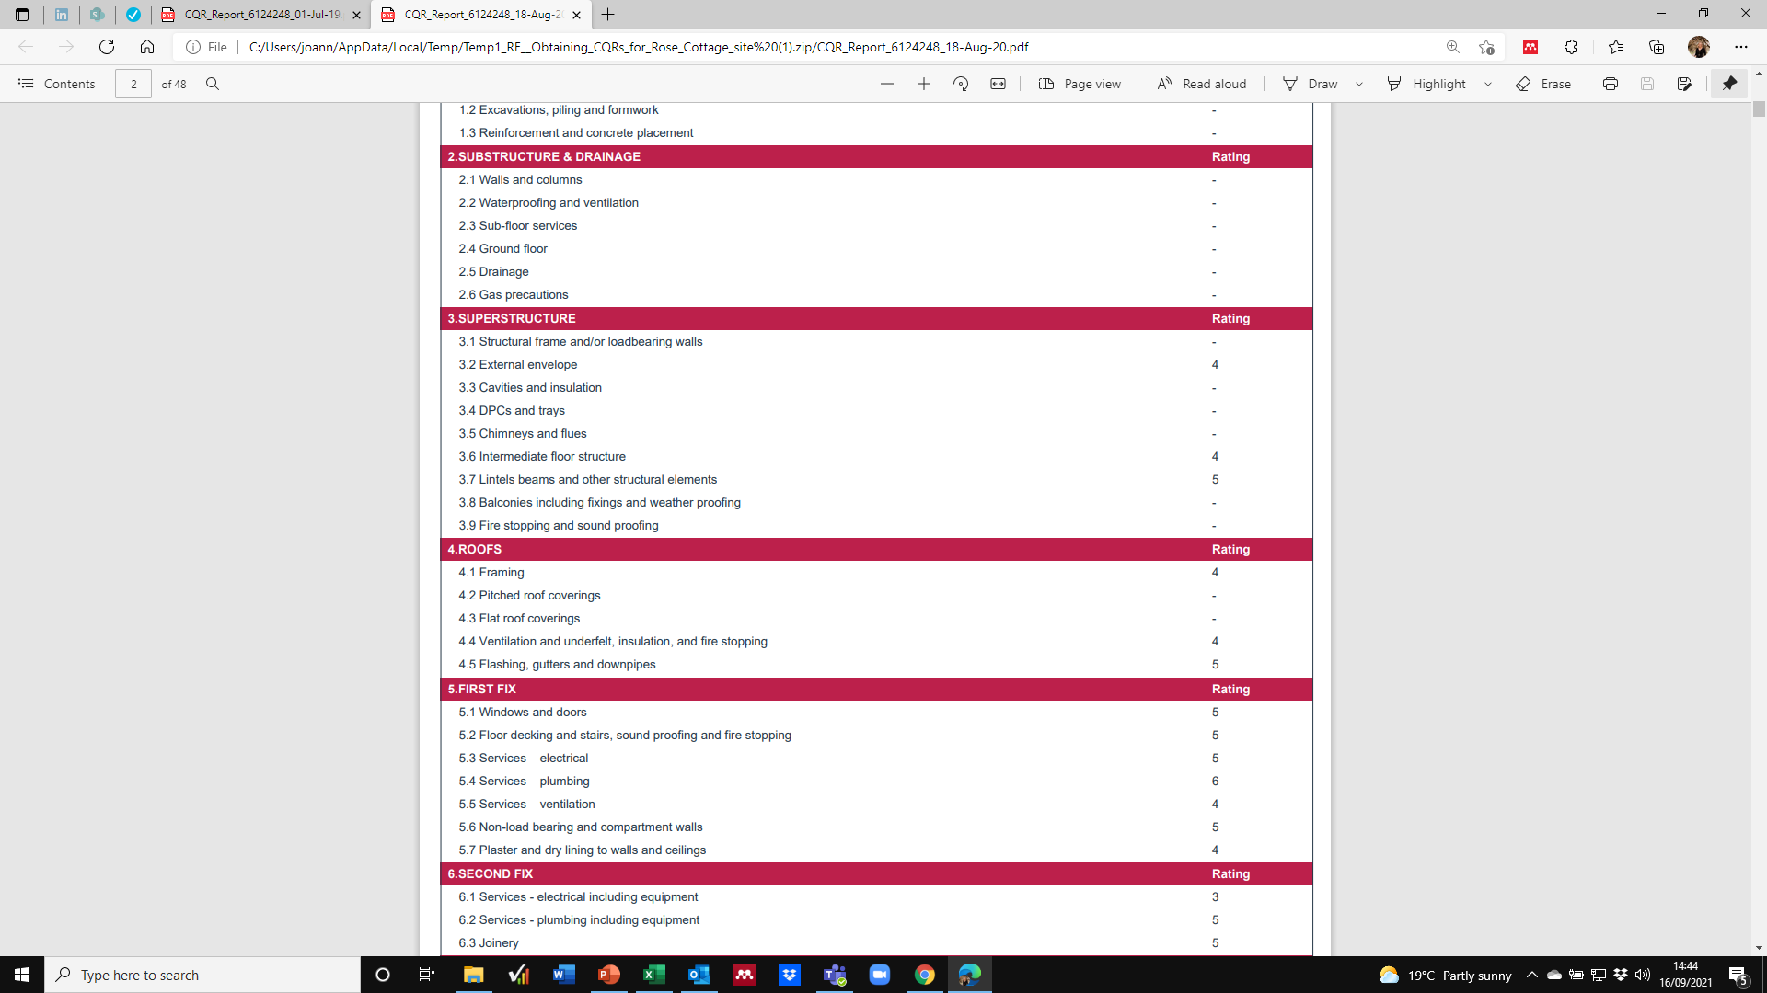
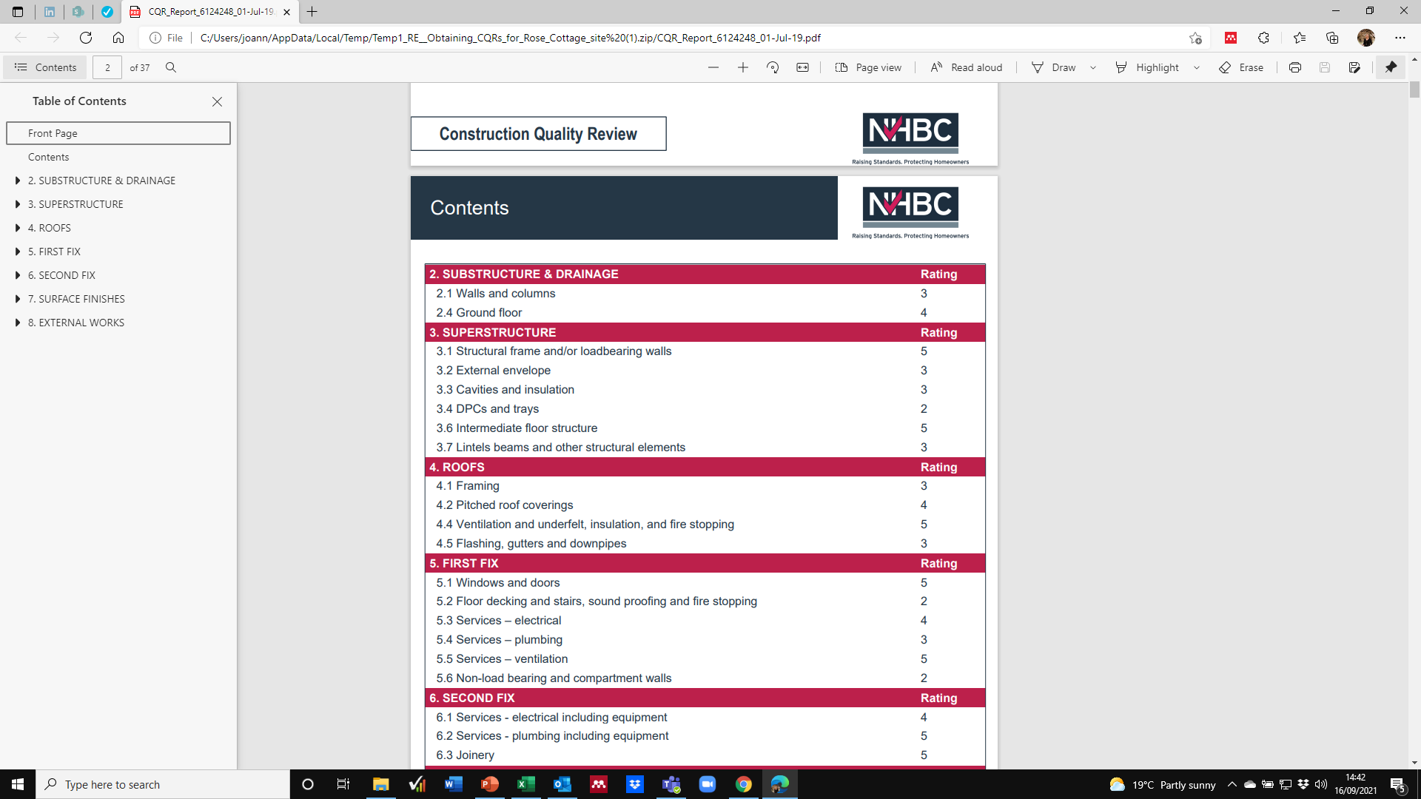
Case study 1 – CQR (1)
2019 (pre-brickwork masterclass)
2020 (post-brickwork masterclass)
NHBC Site Assessment (pre-brickwork masterclass)
NHBC Site Assessment (post-brickwork masterclass)
Requires Improvement
Some minor non-compliance(s) with NHBC Standards and/or Building Regulations
Good
Meets NHBC Standards and Building Regulations
+1

Slide 27
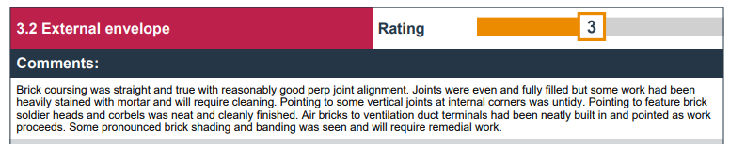
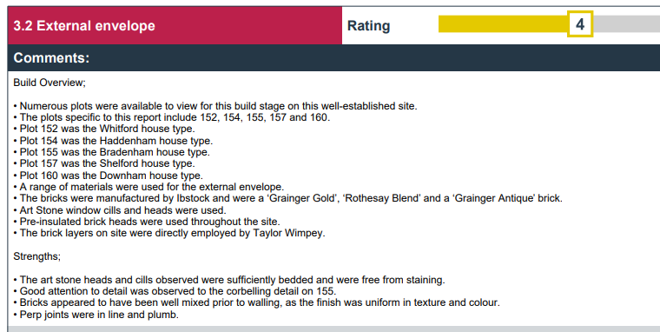
Case study 1 – CQR (2)
2019 (pre-brickwork masterclass)
2020 (post-brickwork masterclass)

Slide 28
Case study 2 - overview
Context
At the time the brickwork masterclass took place the brickwork team were employed through a subcontractor. Post-lockdown, the housebuilder wanted to reduce their use of subcontractors; as the bricklayers wanted to remain on the site they elected to work directly for this housebuilder on a self-employed basis. The team's productivity was good, however, there were some issues with quality of the work.
Outcome and impact
The SM felt that the session was “pitched just right”. The NHBC trainer was knowledgeable and the bricklayers respected that and were highly engaged, asking many questions. The SM has seen that their knowledge has improved, and the brickwork masterclass taught them more about the impact that defects have in terms of insurance and delays which has helped them to understand the consequences of poor workmanship. Internal company inspections suggest the quality of the brickwork has improved.
While it is possible that improvements could also be in part as a result of the change to the bricklayers' employment situation, the SM doesn’t think this is the case. Fundamentally, the quality of the work has improved and there are fewer issues and problems, and a lower number of defects occurring.
The SM also feels the brickwork masterclass has had an additional benefit in so far as it has made the management of the bricklayers easier due to their increased knowledge and understanding.

Slide 29
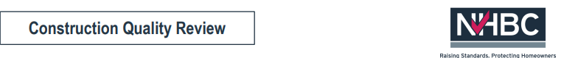

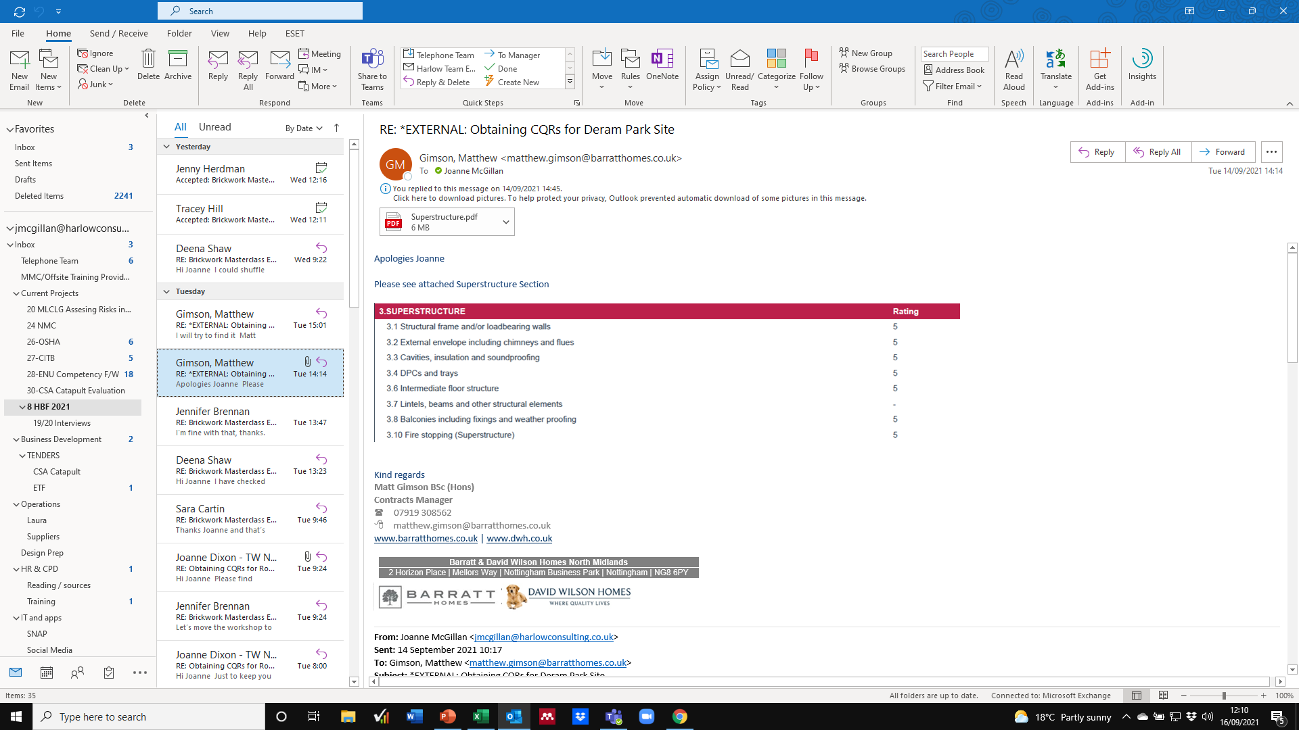
Case study 2 – CQR (1)
NHBC Site Assessment (post-brickwork masterclass)
Very good
Meets NHBC Standards and Building Regulations PLUS some extra attention to detail over and above minimum requirements
Overview comments:
Quality seen was consistent on these plots
A good line and level to blockwork was achieved
Bed and perp joints were even and fully filled
Finish was uniform in colour, without excessive banding, and was free from unacceptable damage and mortar staining to the brickwork
Window and door openings were square without excessive tolerances
Cavities were consistent in width
Mortar droppings were not evident in cavity trays
Correctly positioned cavity trays present over all openings

Slide 30
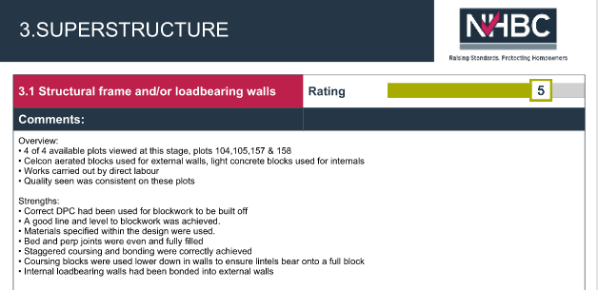
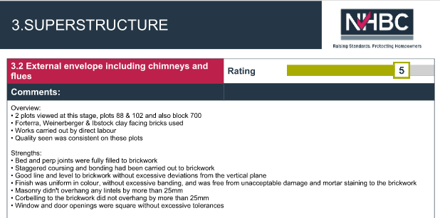
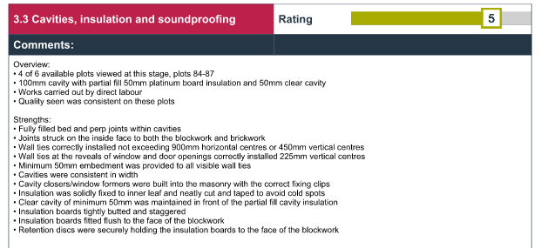
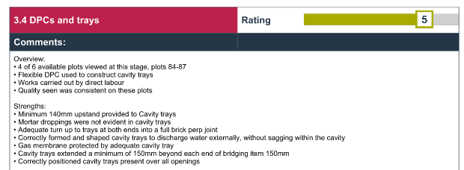
Case study 2 – CQR (2)

Slide 31
Case study 3 - overview
CQR Site Assessment ratings pre- and post- brickwork masterclass
Context
Bricklayers on-site are subcontracted. The site provided a good space to hold the brickwork masterclass and bricklayers from the subcontractor’s other sites also attended the brickwork masterclass. Attendees engaged well with the session, which was particularly noticeable during the Q&A session.
Outcome and impact
The SM believes the brickwork masterclass has had a significant impact – bricklayers’ knowledge and understanding of why things are done in a certain way has increased, and as such their confidence and attention to detail has improved, as has the quality of their work.
Since the brickwork masterclass was held, the site have developed checklists based on the NHBC guidelines for all the trades and the site has achieved the highest CQR score (5.28) ever for any of the developer’s sites in the country. Specific knowledge areas where the SM found improvements (as a result of attending the brickwork masterclass) spanned party wall tie spacings and the use of thermalight blocks.
 | Pre-brickwork masterclass | Post-brickwork masterclass
Walls and Columns | 4 | 5
DPCs and Trays | 5 | 6
Firestopping (superstructure) | 5 | 6
Overall rating | 4.88 | 5.28

Slide 32
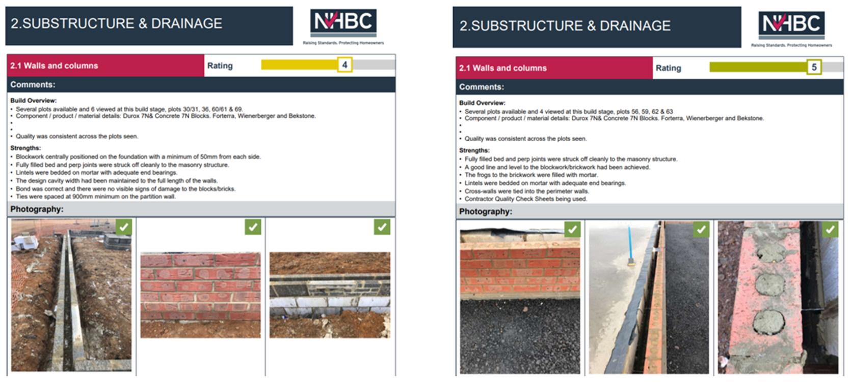
Case study 3 – CQR (1)
Draft
Pre-brickwork masterclass
Post-brickwork masterclass

Slide 33
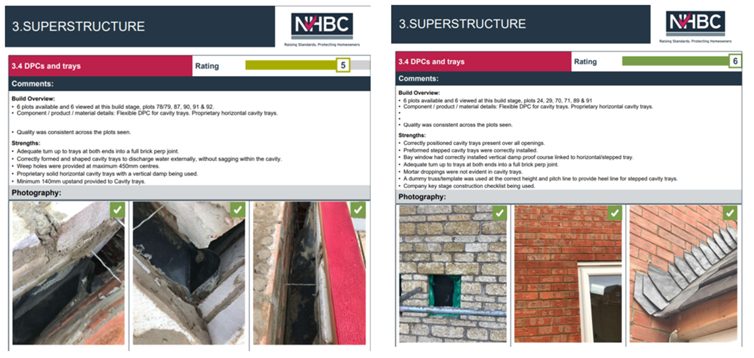
Case study 3 – CQR (2)
Draft
Pre-brickwork masterclass
Post-brickwork masterclass

Slide 34
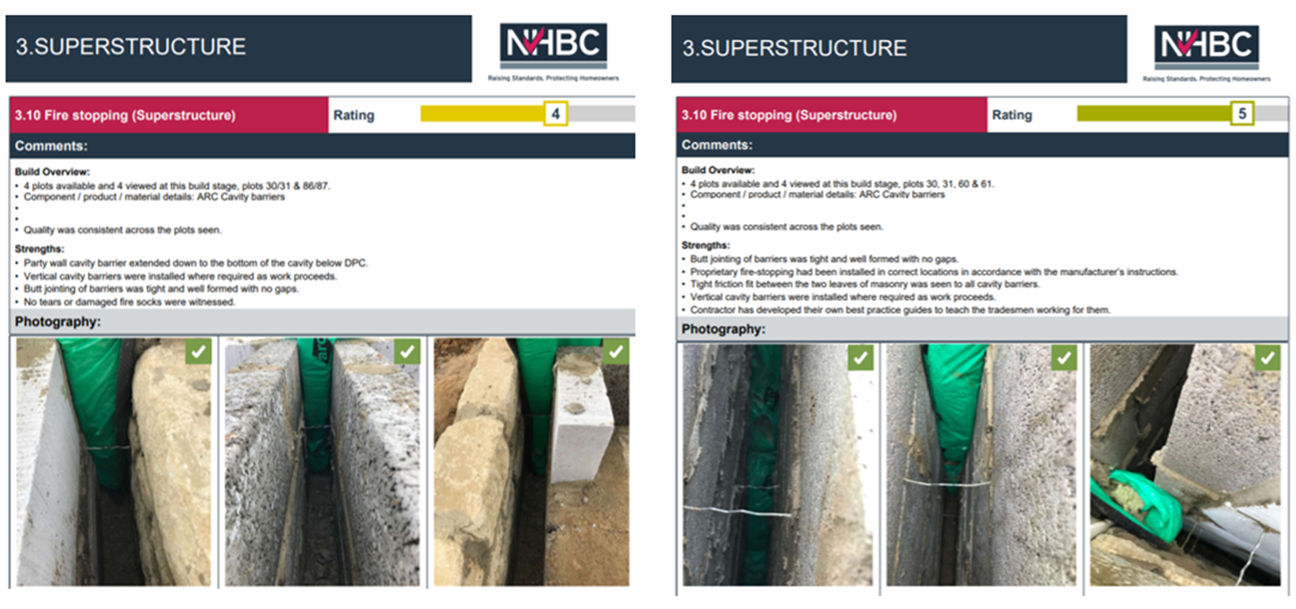
Case study 3 – CQR (3)
Draft
Pre-brickwork masterclass
Post-brickwork masterclass

Slide 35
Case study 4 - overview
Context
On-site, there are three bricklaying gangs, all are self employed and the site manager describes the team as “stable and settled”. A brickwork masterclass was held in February 2022, delivered by an NHBC Inspector from another area. After “a bit of a battle”, the bricklayers engaged with the session, settled down, listened and engaged.
Standards of work on-site have historically been low in some areas, which the SM attributes to a lack of knowledge and supervision.
Outcome and impact
The NHBC inspector worked hard to engage the group and provided specific, useful guidance on lintels - an area with which the site has had issues in earlier CQRs.
After the brickwork masterclass, the SM took the bricklayers around site and identified aspects of work (including lintels) which had been discussed and how this would need to be addressed moving forward. The SM believes that this practical approach really helped with the bricklayers’ level of understanding and commitment to improving quality.
Since the brickwork masterclass, the SM has increased the number of site inspections carried out and quality performance booklets have also been introduced and tightly managed.
The SM believes that the brickwork masterclass acted as the catalyst for improvements on-site – providing knowledge to both bricklayers and their supervisors to ensure standards improved. The latest CQR shows the rating for lintels, beams and other structural elements has risen from a rating of 3 (requires improvement) to a rating of 6 (outstanding).

Slide 36
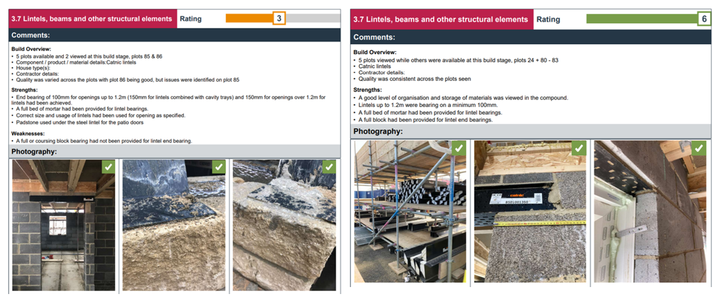
Case study 4 - CQR
Draft
Pre-brickwork masterclass
Post-brickwork masterclass

Slide 37

Site Manager suggestions for the future of brickwork masterclasses

Slide 38
Site managers - suggestions for the future of brickwork masterclasses
Tailored examples used in the brickwork masterclasses
The examples of defects/poor practice used in the brickwork masterclass were thought to lack ‘relatability’ by a small proportion of SMs. It was suggested that on occasions the examples used were “too extreme” and caused bricklayers to disengage with the brickwork masterclass, thinking that as their work was of a higher standard than the examples provided, the brickwork masterclass wasn’t aimed at them. SMs also call for consideration to be given to inclusion of a site tour to identify examples of good and poor practice. This was felt to be a potentially powerful tool in engaging bricklayers and one which would overcome any question of relevance or relatability.
SMs suggest that benefit could be gained from using timelapse videos rather than still images to show examples of good and poor work. The benefit of timelapse videos was felt to be two-fold. Firstly, they show HOW the work was done which would likely stimulate additional learning and questions and secondly, that videos would likely increase engagement.
Content and focus of the brickwork masterclasses
A minority of SMs felt that brickwork masterclasses could be improved particularly for more experienced bricklayers by focusing on one aspect of brickwork rather than a broader range. When site construction differed from the norm (e.g. timber frame or high rise) SMs highlighted a desire for the brickwork masterclasses to be specific to the work being undertaken to both encourage engagement and knowledge acquisition in relevant areas. One SM suggested that the content should be adapted to include more about products, as NHBC are now asking more questions in relation to specifications.
Knowledge acquisition and retention
The suggestion was made to incorporate a mini-quiz at the end of the brickwork masterclass. Something simple and quick to complete (multiple choice) which would help to ensure attendee attention was held for the entire session. The quiz would also provide a measure of the level of knowledge of the bricklayers in attendance. It was also suggested that holding a reminder session after 12 or 18 months may help to ensure improved working practices are maintained in the longer-term.
Many SMs called for the brickwork masterclass handouts to be made available digitally for future use. It was suggested these could be re-issued to bricklayers as necessary, displayed on-site and given to bricklayers new to the site.
Targeted brickwork masterclasses
SMs felt that brickwork masterclasses should be targeted at sites with a high level (or an increasing number) of Repairable Items (RIs) and held at regular intervals until such a time that improvements have been made.
The majority of SMs suggest expansion of the scope of the brickwork masterclasses to include other trades. Groundworks, carpentry and roofing were the trades most referred to as those where there was the greatest need.
Include a site walk to make it more relatable and relevant
Masterclasses for ground workers - it would help them to understand what is looked for re drainage, foundations and brickwork
Get them looking at real examples - some of the examples used are so far out they aren't relatable - they sit there thinking well, I wouldn’t do that, so this doesn’t apply to me.

Slide 39

Conclusions and recommendations

Slide 40






Headline conclusions
On-site brickwork masterclasses make a difference to the quality of brickwork on-site and contribute to reduction of defects and an increase in confidence and skills of bricklayers.
FE brickwork masterclasses make a difference to the quality of brickwork teaching, leading to increased confidence and ability to tailor content directly to the needs of industry.
Delivery of the brickwork masterclasses by NHBC inspectors is a critical success factor, due to their knowledge of quality control, defects encountered and technical expertise.
Brickwork masterclasses engage and benefit bricklayers with a variety of levels of experience. More experienced bricklayers particularly benefit from the open-ended Q&A sessions.
Site managers have changed processes and quality control as a direct consequence of the brickwork masterclasses. However, not all organisations implement a structured action plan post-brickwork masterclass to ensure key benefits are retained over the longer-term.
There is clearly strong appetite for the brickwork masterclasses to continue, and be broadened out to span other trades.

Slide 41
Recommendations
To further strengthen the brickwork masterclasses intervention, the following recommendations are made:
Increase the number of on-site brickwork masterclasses available to reach a greater proportion of the bricklaying workforce
Revert back to running FE brickwork masterclasses (in addition to on-site brickwork masterclasses) to ensure brickworkers of the future have the skills required, helping to ensure defects on site can be prevented by addressing within training. Face-to-face delivery method is preferred; however, online delivery should be considered if budget constraints are restrictive.
Expand the scope of the brickwork masterclasses to include other trades, beginning with those where quality issues and defect occurrence is most common e.g. roofing
Consider a mix of delegates for a small sample of future brickwork masterclasses, bringing together employers, FE tutors, assessors, and awarding organisations, and assess the effectiveness of this slightly different approach
Encourage on-going networking and sharing of best practice within FE, for example via a dedicated LinkedIn group to maintain discussions and momentum about raising standards
Make brickwork masterclass resources available electronically post-brickwork masterclass to enable these to be downloaded, printed, distributed and displayed
Develop an on-site brickwork masterclass follow-up action plan template and suggestions for change which can be made available to SMs electronically, to help embed change over the longer-term
To maintain bricklayer proficiency in the long-term, consider holding follow up on-site brickwork masterclasses at two levels; one covering existing core content, and one at an advanced or bespoke level, to strengthen particular techniques at a site or (large) organisation specific level.
Create a bricklayer training register of those attending site brickwork masterclasses – benefits are two-fold: allows for attendance monitoring and creates a database of workforce contacts which can be used to feed information through to directly (particularly relevant due to varied employment status of bricklayers)
Continue to target sites which are underperforming and prioritise these for brickwork masterclasses

