Slide 1





LESSON 2
Private Spaces in Construction

Slide 2



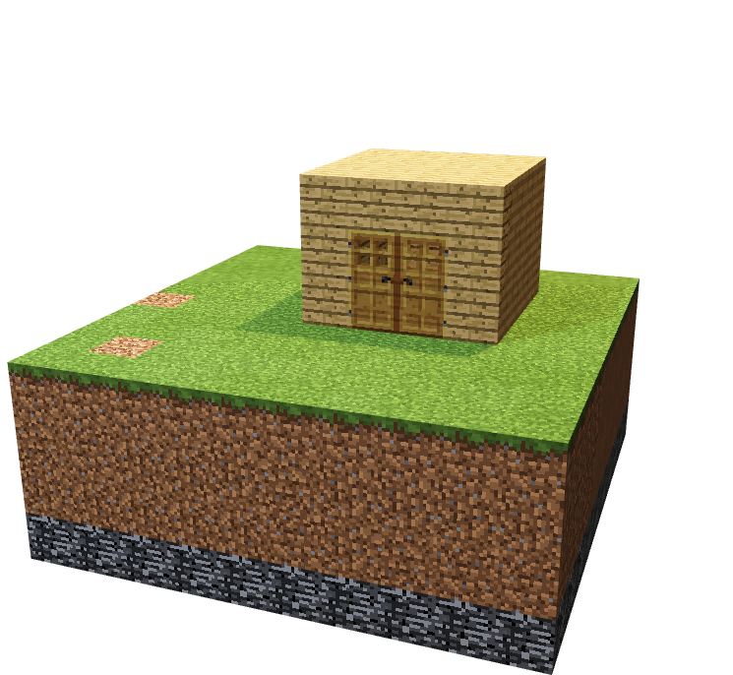
To get familiar with gameplay and features of Minecraft
To construct basic buildings and use various inventory tools and items

Slide 3


Urbanisation
Private Spaces
Common Space
Public Space
5. Multifunctonal
HINT: Look for the torches

Slide 4



Have you constructed buildings in Minecraft??
What are some of the material you used ??
Seen in your own neighbourhood or anywhere in the real world? ?
What type of spaces were they ?

Slide 5
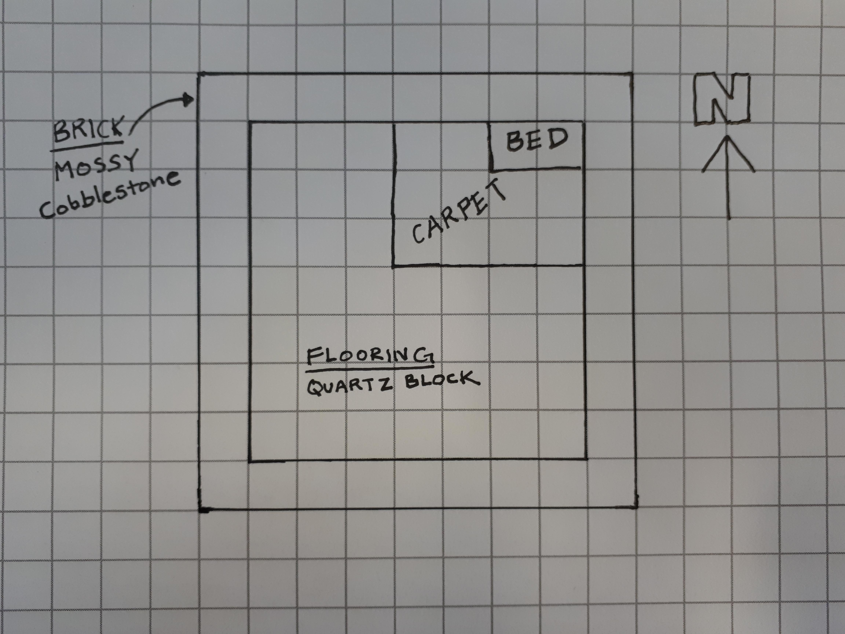
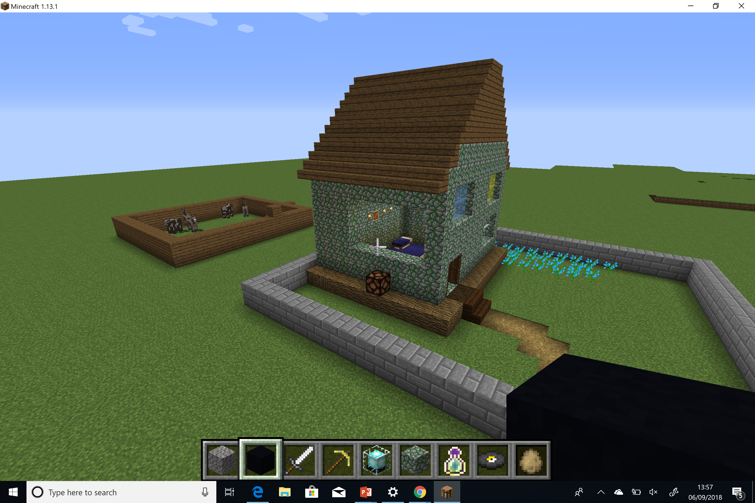
PRIVATE SPACES
<Insert Image of grid design and picture of constructed house on next slide with questions>
Notes:
What makes this a private space? What materials did they use? How do you think they split up this job amongst the team?

Slide 6



Camera challenge
                Take a picture of your quick builds and archery targets from yesterday!
                Add the pictures to your portfolios and add a quick caption.

Slide 7
Design
                Determine the perimeter/area of your building.
                Design the interior and decide on them materials you will use.

Slide 8

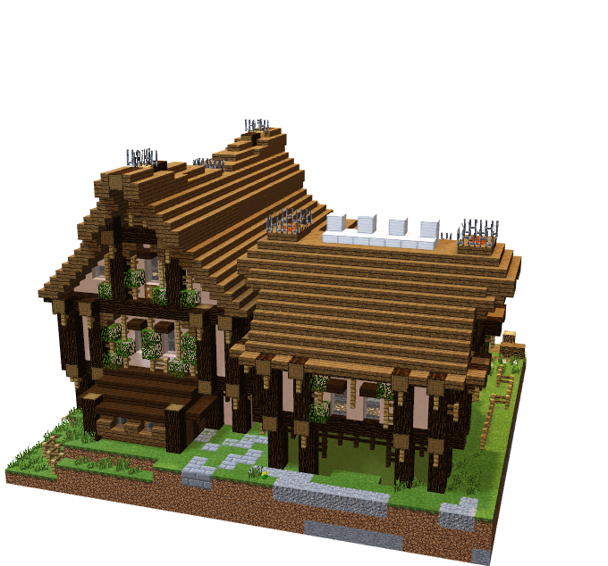
Build based on your designs#
Construct your building based on the agreed design
Be aware of time!

Slide 9


Extension 1:
Add double doors to your building
extension 2:
Add a sunroof (6 blocks max)
extension 3:
Add a basement (4 blocks max depth)

Slide 10

BE PREPARED TO ANSWER THE FOLLOWING QUESTIONS AS A TEAM AT THE END OF YOUR BUILD:
What have we built? ?
What makes it a private space? ?
Did you follow your plan? ?
How did you perform together as a team? 1 -10) ?

Slide 11



WHAT CAN WE TAKE AWAY
FROM TODAY?
What areas are left to add to our build ?
Where will it be placed?
What new role will you take on the next lesson?

Slide 12
Day 2

Slide 13






Go Construct - Educate Consortium led by Bouygues UK

