Slide 1
Are you part of the Leadership and Management in construction movement?
6 June 2023

Slide 2
Agenda
Why is CITB investing in Leadership and Management Training?
What the research is telling us?
Benefits of the qualification
Flexibility of the offer
Eligibility
Introduction to the Providers (overview of each) and their geographical reach
Learner testimonies
What next? How to access the Training available?
Please note, this event is being recorded

Slide 3
Construction Leadership & Management Overview
There is currently a widespread lack of L&M skills which is hampering industry’s productivity. We need to increase training activity. We know the key barriers to training, which particularly impact the micro, small and medium employers, are:
  Cost of training / qualifications
  SMEs find it hard to identify a training need, and then find the best training to go for
Where L&M training is taking place, predominantly in larger employers, it is very fragmented and company-specific with a lack of transferability at the core level. We need a mechanism to recognise and encourage take up of equivalent training.
In terms of skills lacking in the labour market, 66% of skill-shortage vacancies were at least partially caused by a lack of people and personal skills. This represents a substantial drop from 2017 (75%), falling closer to 2015 levels (70%). Over two-fifths (44%) of skill-shortage vacancies were at least partially attributable to a lack of ‘management and leadership’ skills, such as managing or motivating other staff, persuading and influencing others, and setting objectives and/or planning resources.
In 5 years' time CITB would hope that by rolling out this standardised training programme across the industry we would see a shift in the approach of management within the industry, leading to improved productivity, increased staff retention and staff satisfaction.

Slide 4
CITB Commission
The objective of the Leadership and Management commission is to provide free of charge training to 10,500 Front Line Managers, Site Supervisor and Site Managers. This is in the form of 5 C-ILM modules. If the individual attending the modules has the time, desire and ability, then they can choose to proceed with completing the assessments to obtain an Award (2 mandatory modules assessed) or Certificate (5 modules assessed) in a level 3 ILM Leadership and Management Practice for the Construction and Built Environment Sector.
The five available modules vary by supplier but will come from the list below:
Mandatory modules:
  8626-300 Leadership and Management Practice for the Construction and Built Environment Sector
  8626-301 Delivery of Site Operations and Logistics
And any further 3 modules from the list below
  8626-302 Understanding Commercial Awareness
  8626-303 Handling Difficult Situations
  8626-304 Reading and Executing a Short-Term Programme
  8626-305 Achieving Performance Through People

Slide 5
Who is the qualification for?
These non-technical qualifications are aimed at team leaders, supervisors, foremen and site managers seeking to gain a thorough understanding of leadership and management principles to effectively lead, supervise and safely manage staff in the built environment and construction industry.
Results for you
Get a solid grounding in the operation of construction projects and programmes
Learn site and staff management techniques
Manage and lead site safety and workplace behaviour
Develop skills to effectively lead, supervise, and communicate to teams
A national qualification to support you in obtaining your Academically Qualified Person (AQP) card through the Construction Skills Certification Scheme (CSCS).
Impact for your employer
Ensure best practice in people and site management
Safer and more efficient use of physical, fiscal and human resources
Managers with proven application of skills for tenders and major contracts
Staff who meet the technical and competence needs of programmes and projects

Slide 6

Commission Eligibility
Trainee’s taking up the free offer must have a full-time contract of direct employment (PAYE) with a Levy registered employer or be a CIS subcontractor to the Levy registered employer. Free spaces are not available for subcontracted labour or those individuals that are self-employed.
CITB funded free spaces for this training are available to all in-scope CITB registered employers who do not have any outstanding levy submissions.
The suppliers are allowed to charge a registration fee of up to £137, and a non-attendance fee up to £100, but the remainder of the course should be offered for free.
Employers putting forward candidates for the free training places will not be permitted to claim the short qualification grant for these employers, but they may have already completed Leadership & management short duration courses. Any courses already attended will have to be completed again with the ILM provider to ensure they can proceed to the qualification if desired.
Trainees must have commenced all their modules between 1st December 2022 and 31st March 2025. Assessments can be completed up to 31st July 2025
There are currently 3 providers delivering this commission.
The OM Group – covering all the UK
MKC Training – covering the South of England
Danny Sullivan Group – covering the South of England

Slide 7




Who we are
Specialists in learning delivery, design and consultancy
Considerable expertise in construction and management skills training, gained over decades
We train over 1500 students per year in construction and engineering trades with exam success rates >96%
Trainers and instructors with real industry experience and expertise, L5+ qualified in delivering learning
3 foundations – Military, Commercial Construction, Green and Sustainability
Our CITB ILM offering
3-day Award Course + 4-day Certificate courses
F2F and Virtual
Simple, supported and accessible assessment
5 x criteria-referenced question-based assessments
Just-in-time guidance through bite-sized support videos, email, and virtual group support
What makes us different
An interactive learning experience that brings real behavioural change + qualification
Designed for modern learners - hands-on activities, simulations, group discussions, gamification, video, reflective, case study
High quality training materials
Engaging assessment support with a variety of media

Slide 8
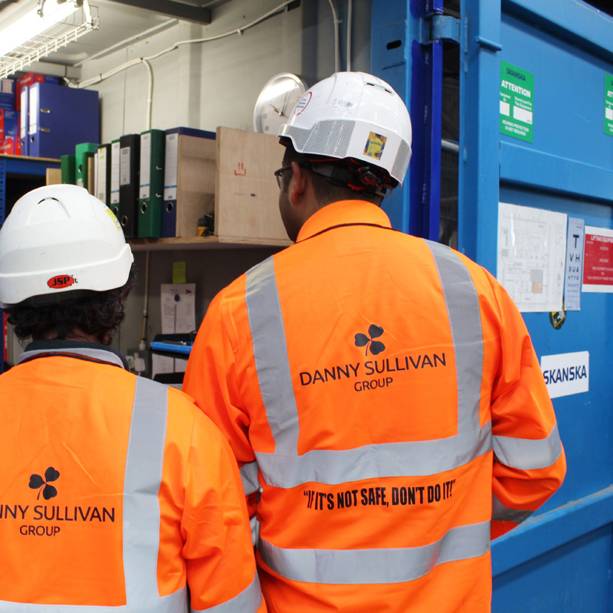


Danny Sullivan Group
  At Danny Sullivan Group, we are a leading supplier of skills trades and labour to UK Infrastructure. Our decision to support the CITB Leadership and Management Fund reflects our recognition of the importance of effective leadership and management in the construction industry. It aligns with our goals of career development opportunities, employee empowerment, and industry improvement.
  As a supplier to major Tier 1 customers nationwide, we are acutely aware of the skills challenges faced by the industry. The Leadership and Management commission offers us all a chance to collectively address this and embed better people leadership skills throughout our industry. We view these skills as of equal importance to formal Occupational Work Supervisor qualifications.
  The support of the L&M fund builds on DSG’s plans to support the industry with high quality training provision through our new division, the DSG Academy Ltd.
  Our courses are run online, with various modules taking place over the month, meaning you can complete in as short or long a time as needed. This method of delivery means employers benefit from a flexible approach that ensures all learners progress and complete.
  Each delegate will have a dedicated tutor and mentor that they can lean on in between sessions when working through their coursework. The portfolio of questions that form the assessment will focus on reflective learning, incorporating both theory and evidence based of their current roles in the workplace.

Slide 9

The OM Group
The OM Group is a multi-disciplinary consultancy and training company, established in 2008, driven by our goal to serve the construction sector.
Our core mission: To be the energy of change within the construction industry.
Value Added Items
Access to a dedicated Training Team
Access to ILM Learning Assistant
A Project Management template pack
Unlimited access to The Construction Helpline for 12 months
Pre-Course
Access to pre-reading material
During the Course
Five modules delivered as five x one-day classroom courses
Assessment
Assigned a dedicated assessor
Delegate Guide
Joining Instructions and information
Short course exam at the end.
Access to e-portfolio system for preparation of the Assessment
Work-based assessment and professional discussions
Access to additional support material

Slide 10
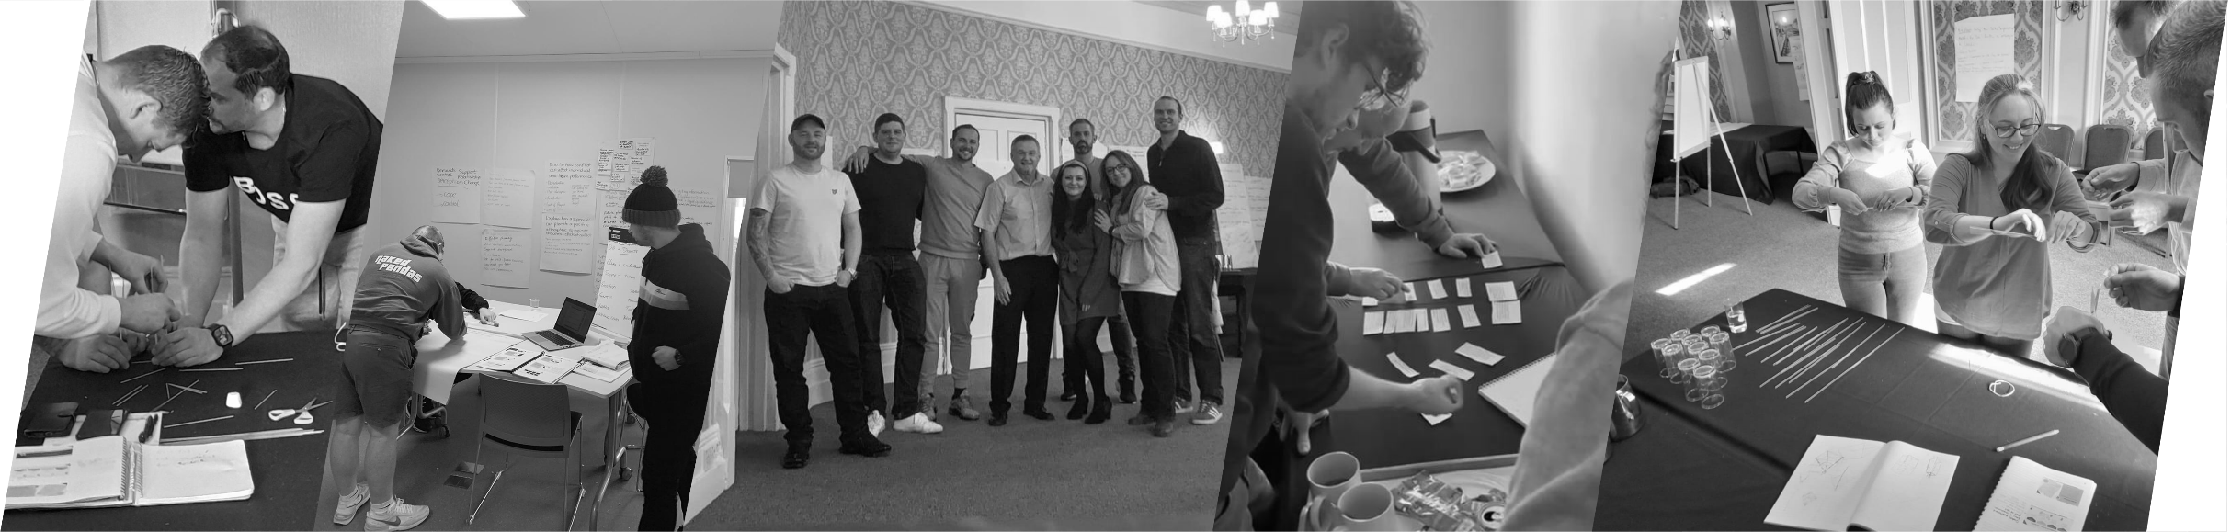

Delegate Feedback
Ian was very engaging throughout the whole course and presented the content in a lighthearted way which was effective and easily digestible - Maidstone
Productive and Empowering
Site Operations Manager
Very well delivered course and great understanding of what he was delivering. Gave me some great things to take away and use in my role in work - Plymouth
‘Good Course well executed. Great instructor’
Site Manager
‘The Course was delivered very well. All the same an enjoyable course’
Supervisor
Very informative, got all of the relative information that I need for my day-to-day work as a manager on-site. If I needed help, Graham was there to attend and very welcoming - Chelmsford
‘On the whole a very interesting and beneficial course’
Asbestos Removal Supervisor
Out of all training courses that I have been on, Glynn has been the most gripping and easy to follow - Plymouth
‘A well delivered course. Very well presented by a confident and humour lead tutor, He is an asset to the company’
Production Foreman

Slide 11
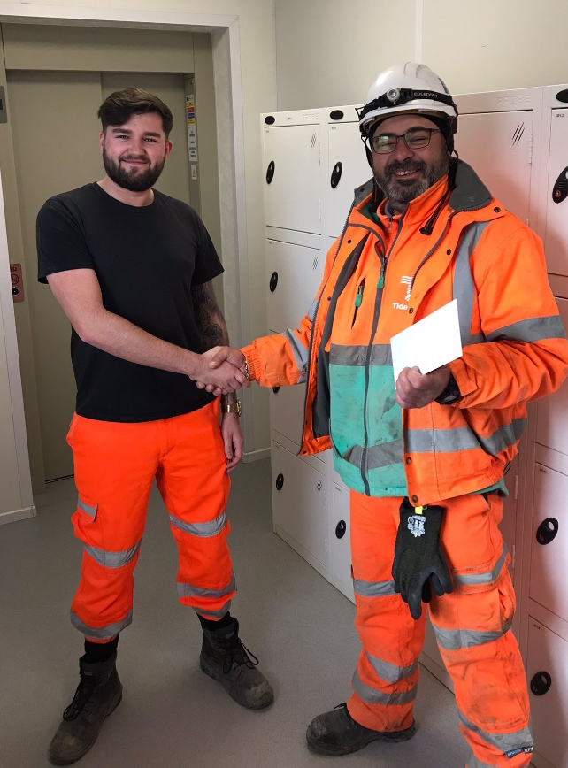


Delegate Feedback
“The Level 3 Leadership and Management Training has been hugely beneficial for me in my role. It has helped me to grow my skills in leading a large workforce and living the behaviours I expect from others. It has helped me gain a much better insight into people performance and what good looks like to achieve that, while also broadening my knowledge around commercial awareness.
The course has been well delivered and the tutors are brilliant. We’re supported as we work through our assessment portfolio, which also helps contextualise the course with my day-to-day activities. I would recommend this course for anyone in our industry looking to build on their management skills.”
Ben, Labour Manager
I have found the Level 3 C-ILM brilliant and it’s really opened my eyes to how much work we need to do as an industry to embed these skills. In my role, connecting with people is so important and this training has really informed how I do that. It’s also built my skills and abilities to have those difficult conversations when needed and in a constructive way.
For me, this is something that we should have all aspiring and current managers trained in. Construction is a people industry and creating a culture of effective leadership is the foundation for us achieving success.
James, Senior HSWS Advisor

Slide 12
Access to Training
MKC Training
www. mkctraining.com/citb
Tel: 01634 383 080
courses@mkctraining.com
Danny Sullivan Group
https://www.dannysullivan.co.uk/employees/free-training/ilm/
Ruairi Coffey : 07590 028868
RuairiC@dannysullivan.co.uk
The OM Group
www.theomgroup.co.uk
0344 288 9000 hello@theomgroup.co.uk
Further information on CITB Leadership & Management funding
https://www.citb.co.uk/courses-and-qualifications/find-a-training-course/leadership-and-management-training/

Slide 13

Any questions?

