Slide 1





LESSON 4
Public spaces

Slide 2



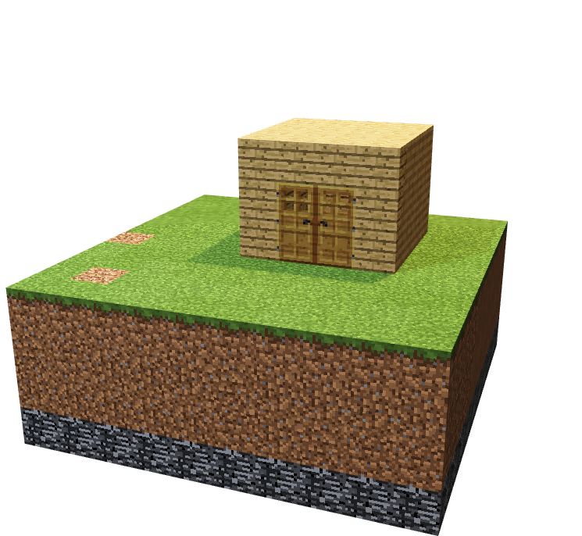
To get familiar with gameplay and features of Minecraft
To construct basic buildings and use various inventory tools and items

Slide 3

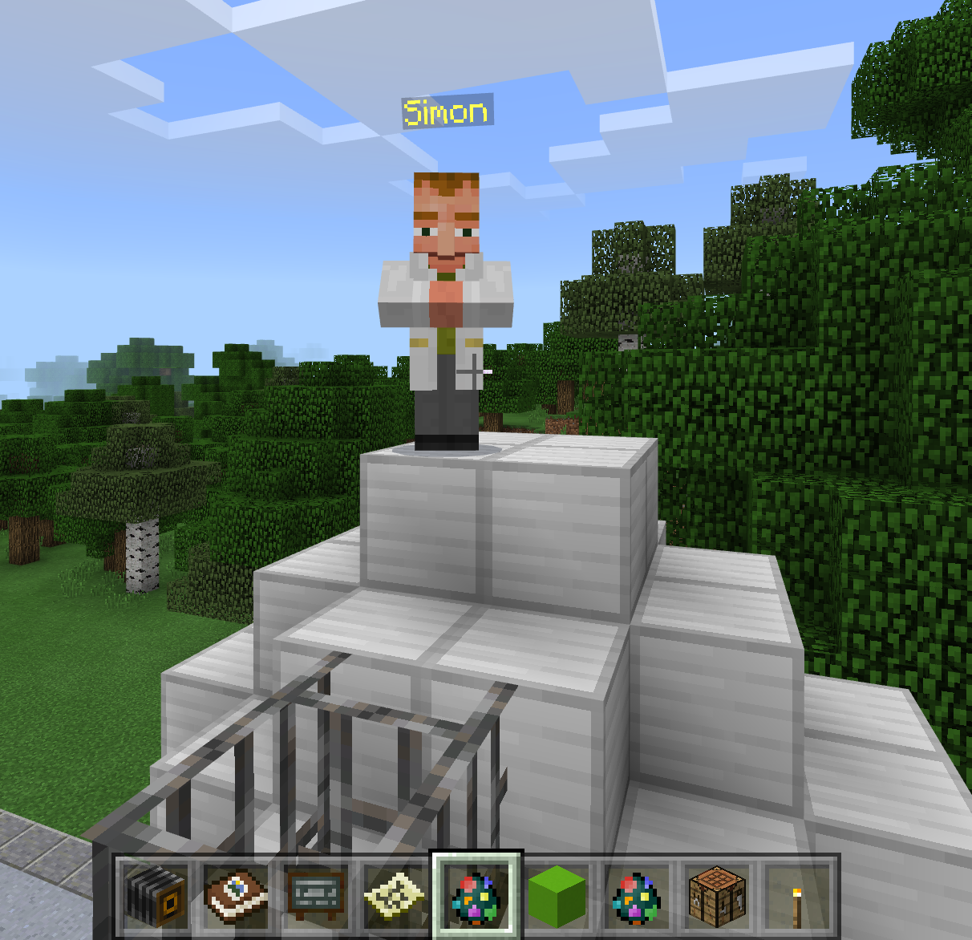
Urbanisation
Private Spaces
Common Space
Public Space
detailing
Look for Simon to get the definitions!
Notes:
Teachers – You can change the screenshot to align with your NPC! ☺

Slide 4
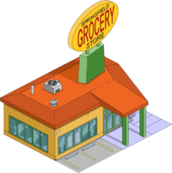
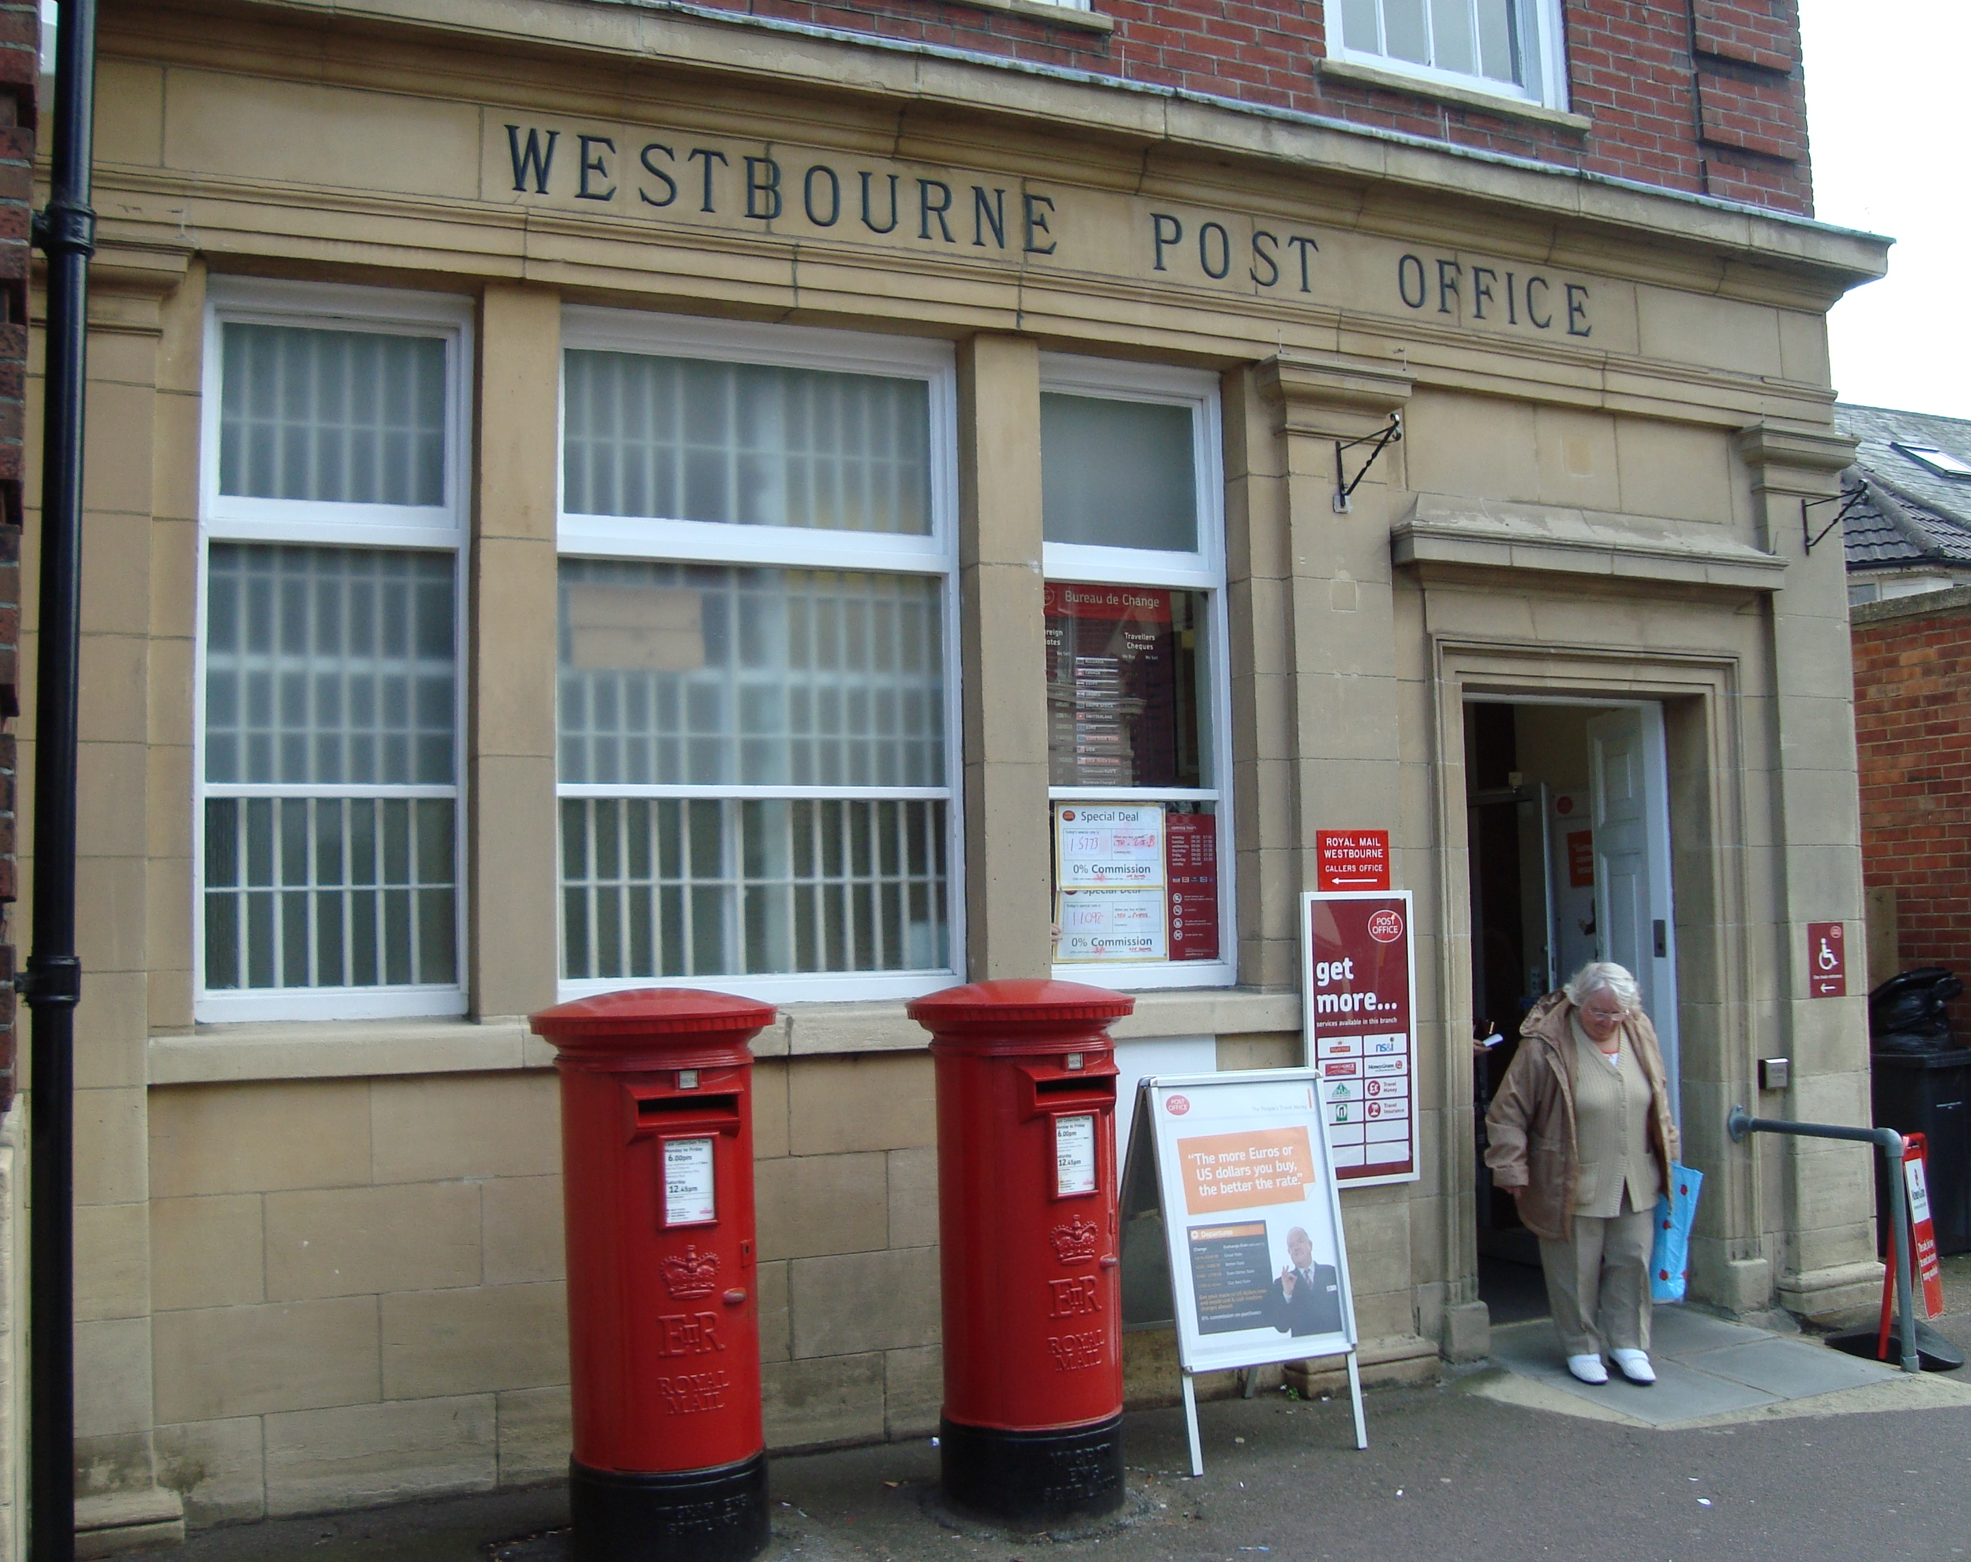
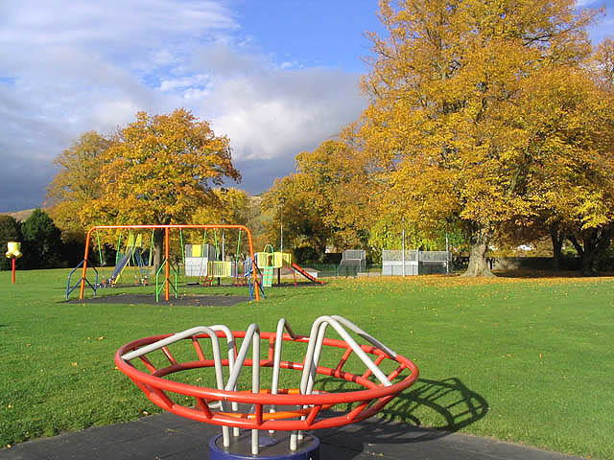

Public Spaces
<Insert Image of grid design and picture of constructed house on next slide with questions>
Notes:
What is the difference between a private and common space? What features define a common space? Can a building contain private and common spaces?

Slide 5


Role Introduction
Project manager
Construction manager
Designer
Notes:
Project Manager: Overall team representative, time keeper, etc. Construction Manager: In charge of choosing materials (able to explain reasons) Designer: In charge of final designs on grid paper

Slide 6

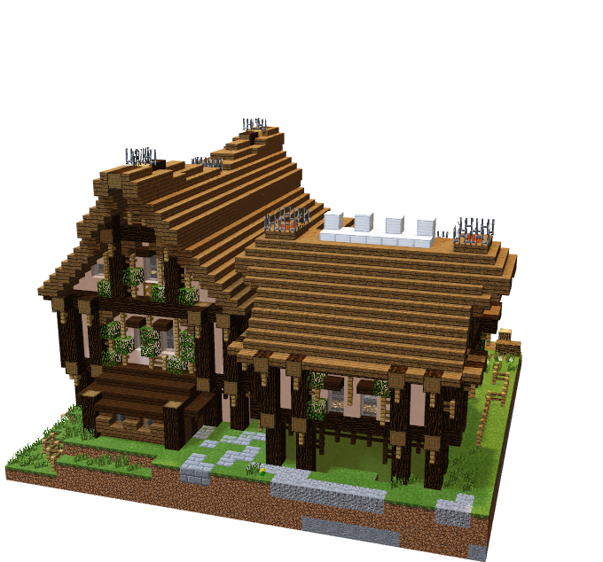
Share your designs#
Construct your building based on the agreed design
Be aware of time!

Slide 7
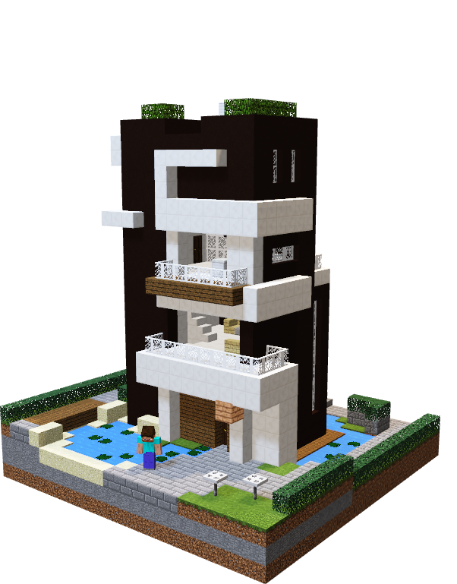

Continue to add detail to your private, common and public buildings/areas.
Add a system of roads and walkways to your project

Slide 8

BE PREPARED TO ANSWER THE FOLLOWING QUESTIONS AS A TEAM AT THE END OF YOUR BUILD:
What have we built??
What makes it a private space??
Did you follow your plan??
How did you perform together as a team? (1 -10)?

Slide 9


WHAT CAN WE TAKE AWAY FROM TODAY?
What do we see developing now as we have added more?
What are you most proud of so far?
What areas/buildings needs your team’s attention?
How will you use your time tomorrow before your team’s presentation?

Slide 10

Day 4

Slide 11






Go Construct - Educate Consortium led by Bouygues UK

