Slide 1





LESSON 1
Explore and Learn

Slide 2


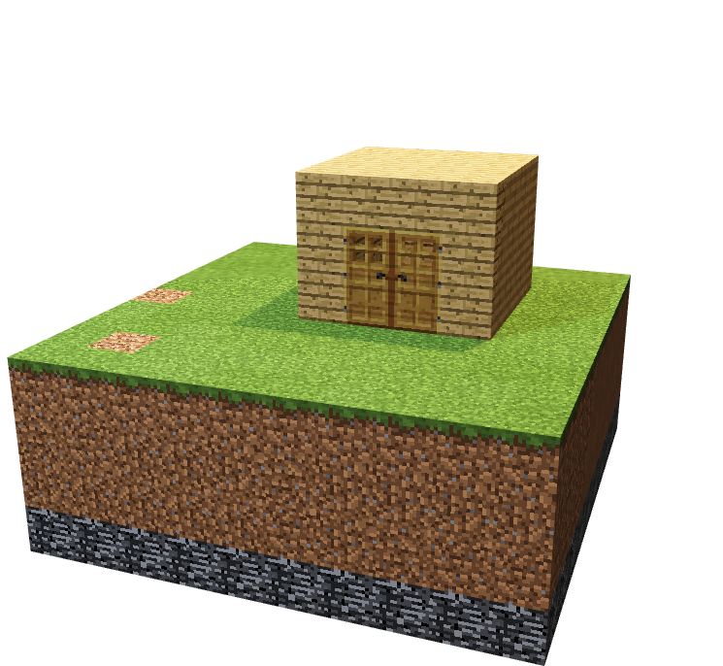
To get familiar with gameplay and features of Minecraft
To construct basic buildings and use various inventory tools and items

Slide 3


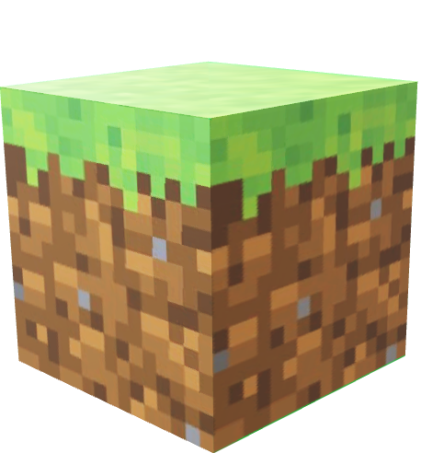
Construction
Demolish
Teamwork
Self Assessment
Time management

Slide 4

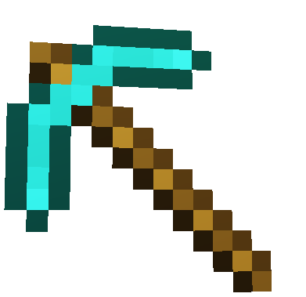
Think-Pair-Share
How many of you have played Minecraft ?
Could you explain how to play to another student? ?
What are the 3 most important things to get started? ?

Slide 5




Can you find THE DEFINITIONS FOR THE VOCABULARY IN OUR WORLD?
How will you do this as a team? ?
Look for the Green Blocks!

Slide 6
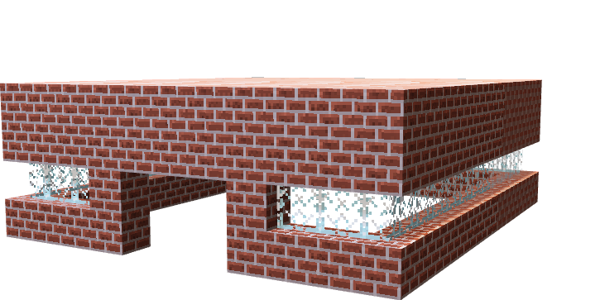
Quick build challenge
Use
10 blocks
20 blocks
30 blocks

Slide 7
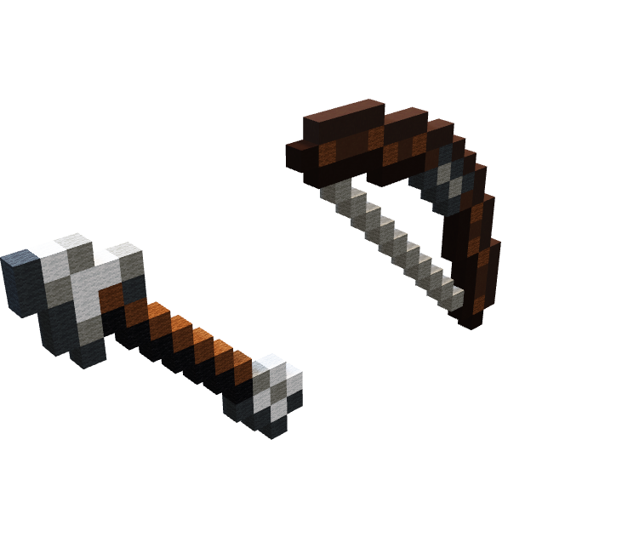
Find a2b guide perri
Construct your target as demonstrated
Use your bow and arrow and see who gets closest to a bulls-eye from different distances!
Notes:
Edit this slide using video slide from lesson 2 and Camtasia edit

Slide 8

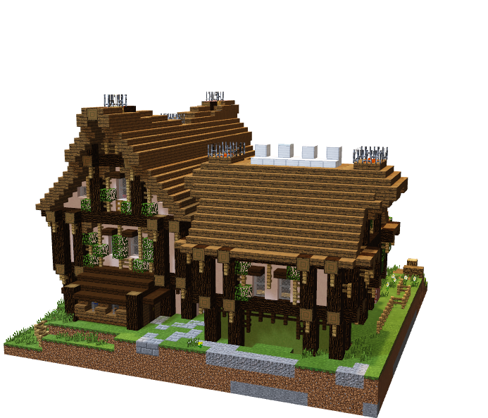
Free build
20 minutes
1
teamwork
2
3

Slide 9

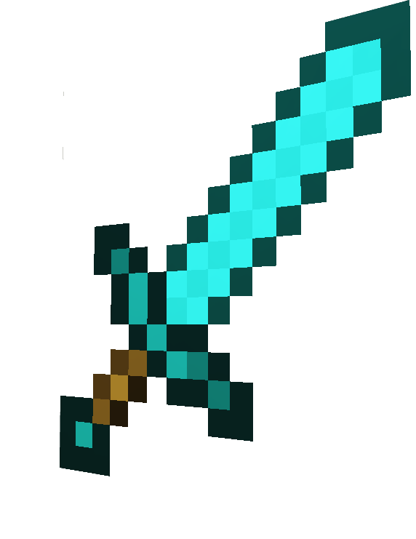
Extension 1:
Add double doors to your building
extension 2:
Lay down carpet inside your construction
extension 3:
Make a pond with water and fish
Extension 4:
Spell the names of all your teammates
using blocks

Slide 10

BE PREPARED TO ANSWER THE FOLLOWING QUESTIONS AS A TEAM AT THE END OF YOUR BUILD:
What have we built??
What makes it a private space??
Did you follow your plan??
How did you perform together as a team (1 -10)?

Slide 11


WHAT CAN WE TAKE AWAY FROM TODAY ?
1. Did the skills used today match with the ones identified at the beginning of the lesson (Think..Pair Share)?
2. What vocabulary word best describes what your team will need to focus on to be successful on our upcoming project??

Slide 12

Day 1

Slide 13






Go Construct - Educate Consortium led by Bouygues UK

