Slide 1





LESSON 5
Final builds and presentations

Slide 2



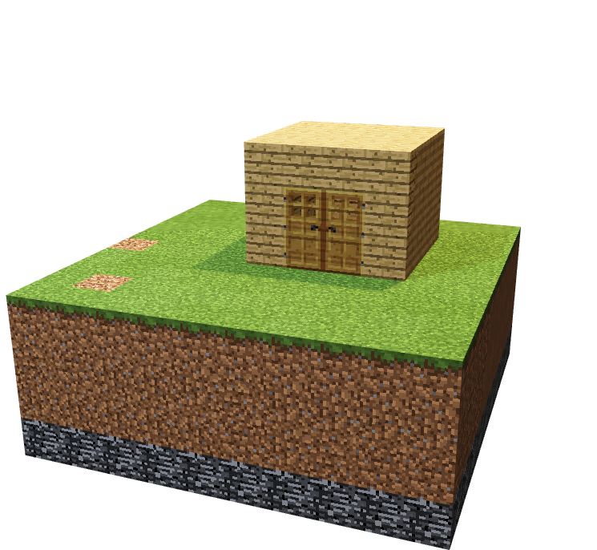
Present a team project using construction roles of :
Project manager
Construction manager
Designer

Slide 3


Project manager
Construction manager
Designer

Slide 4
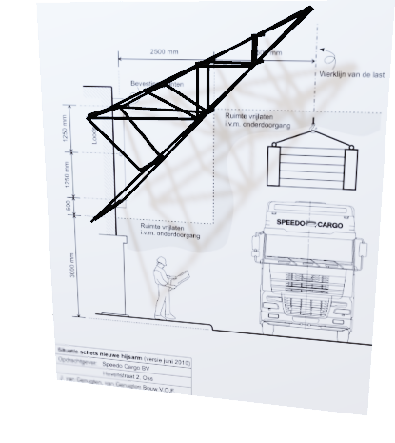
Project manager: What are three things your team was most proud of during this process?
Construction manager: Pick one building to tell us about the material chosen to construct it and why?
Designer: Pick one building and explain what was the most difficult part of designing it?

Slide 5

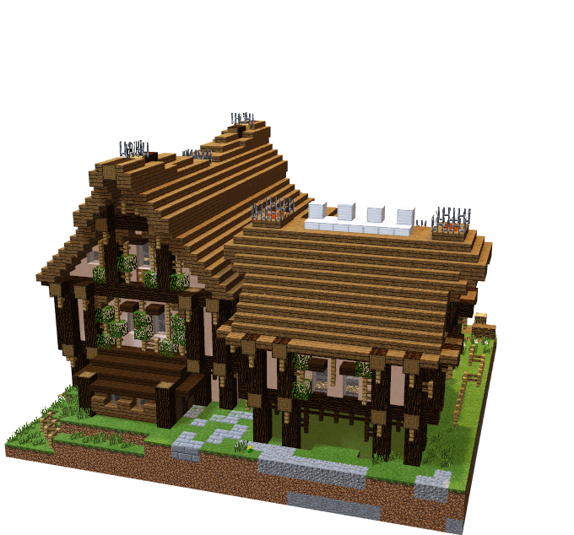
use your designs#
Construct your building based on the agreed design
What is your role ?

Slide 6
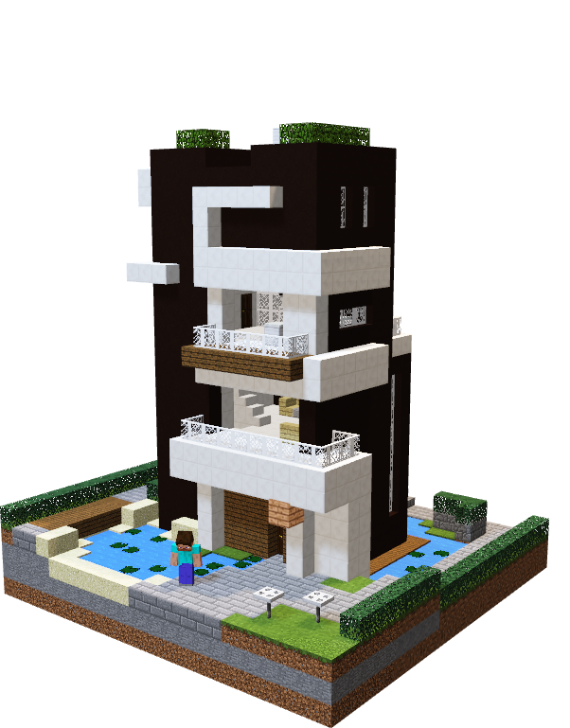

Continue to add detail to your private, common and public buildings/areas.
Add a system of roads and walkways to your project (if time)

Slide 7

Project manager: What are three things your team was most proud of during this process?
Construction manager: Pick one building to tell us about the material chosen to construct it and why?
Designer: Pick one building and explain what was the most difficult part of designing it?

