Slide 1

Construction Training Directory

Slide 2
Grant modernisation focussing on construction related training and removing duplication of training
Giving industry confidence in the quality of training through industry agreed standards
Currently only Short Duration Training with the plan to add in others as the system is developed
What is the role of the ATO?
Give industry confidence in the quality of training
Quality assured
Delivering standardised training
Submitting achievements to automate grant
Purpose
Notes:
Grant Modernisation:

Slide 3
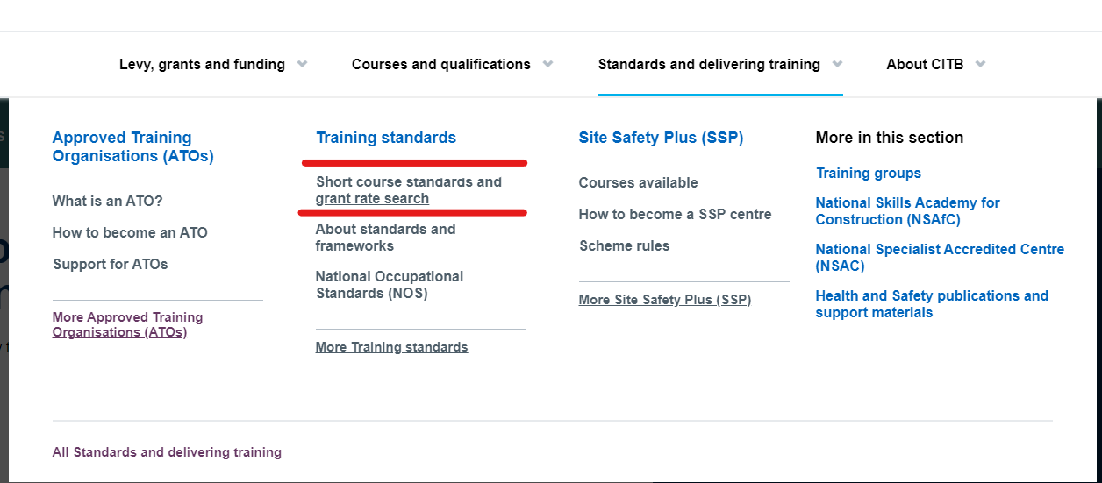
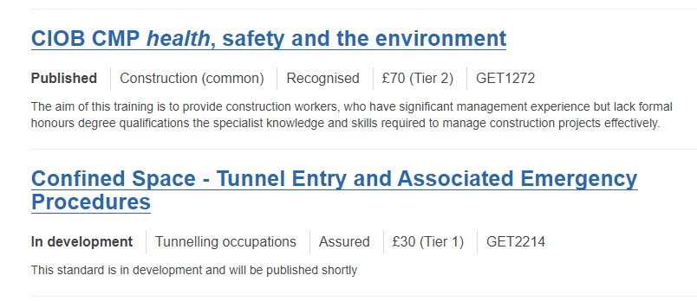
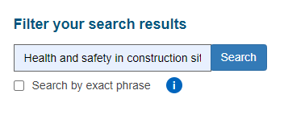
What do we mean by Standardised training?
Standards search page on Citb.co.uk
Standards
Notes:
Standards search page can be found at citb.co.uk, then hovering over “Standards and Delivering Training” then “Short course standards and grant rate search”
Assured = Standard that is being written by CITB with industry and quality assured by CITB
Recognised = There is a Recognised provider already in the industry who has created a course and quality assures that training
Published = Standard content has been identified, either from a Recognised provider or written by CITB with industry. These are grant eligible
In Development = Standard has been identified, but no content has been written yet or no Recognised provider has been confirmed yet. These are also grant eligible.

Slide 4
The system

Slide 5

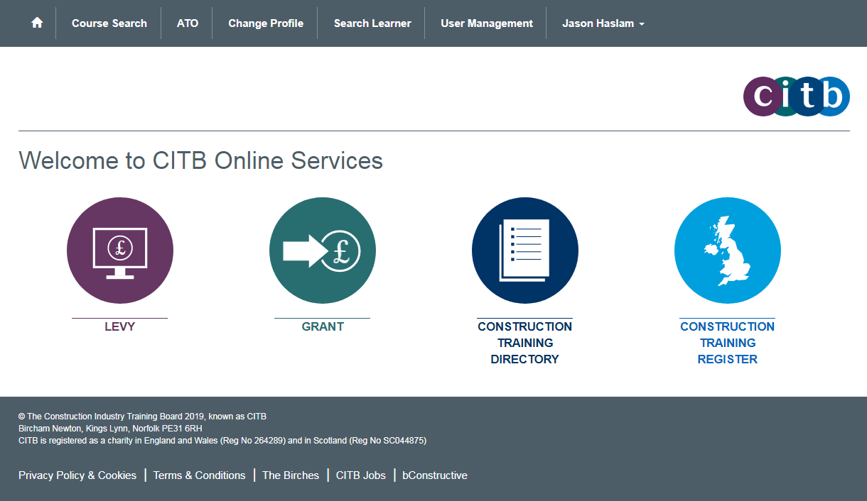
My.citb.co.uk
ATO system access
Submit CITB Levy assessments
Employers search for standardised training courses
Access grant account
Check a learners record
Notes:
This is what the employer sees when they login and the functionality if they click on each of the bubbles

Slide 6
ATO functionality
First time logging in

Slide 7
Following a successful application, you will receive an invitation email. If you haven’t received your invitation email, contact our customer support team on ctdservices@citb.co.uk or 0844 994 4047.
In the email, click “Login to my account”.
Enter the email address that you provided when applying to become an ATO and then click on the “Send verification code” button.
You will receive an email with your verification code. You have 15 minutes to respond and verify this code
Enter the code in the verification box and click “Verify code”.
You will now be prompted to create a password. Click create to submit the form.
On your first log in to the portal, you will be prompted to accept our terms and conditions. Read and accept them to continue.
If you have applied for the Assured or Recognised product category your next step will be to sign your Forms of agreement”
First time log in
Key point
goes here:
Arial 20pt
Key point
goes here:
Arial 20pt
Notes:
Following a successful application you will receive an invitation email. If you haven’t received your invitation email contact our customer support team on ctdservices@citb.co.uk or 0844 994 4047.
In the email, click “Login to my account”.
Enter the email address that you provided when applying to become an ATO and then click on the “Send verification code” button.
You will receive an email with your verification code. You have 15 minutes to respond and verify this code
Enter the code in the verification box and click “Verify code”.
You will now be prompted to create a password. Click create to submit the form.
On your first log in to the portal, you will be prompted to accept our terms and conditions. Read and accept them to continue.
If you have applied for the Assured or Recognised product category your next step will be to sign your Forms of agreement”

Slide 8
ATO functionality
Signing Forms of Agreement

Slide 9
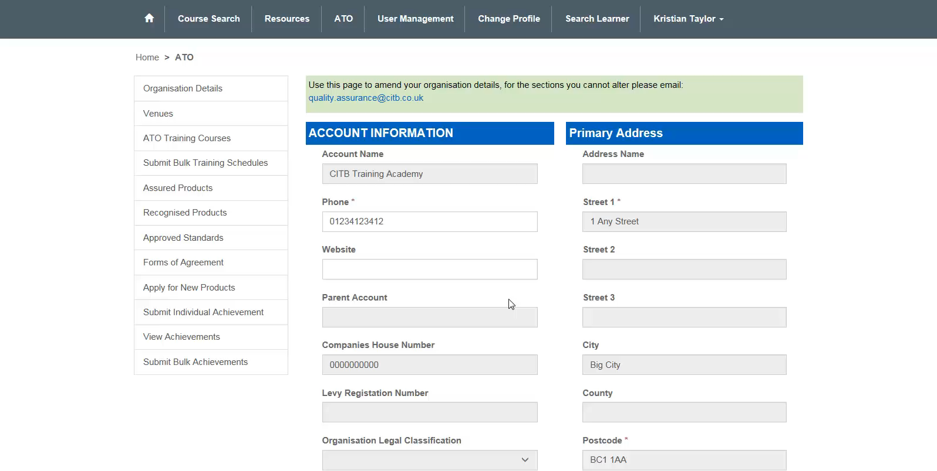

Slide 10
ATO functionality
Applying for new products

Slide 11
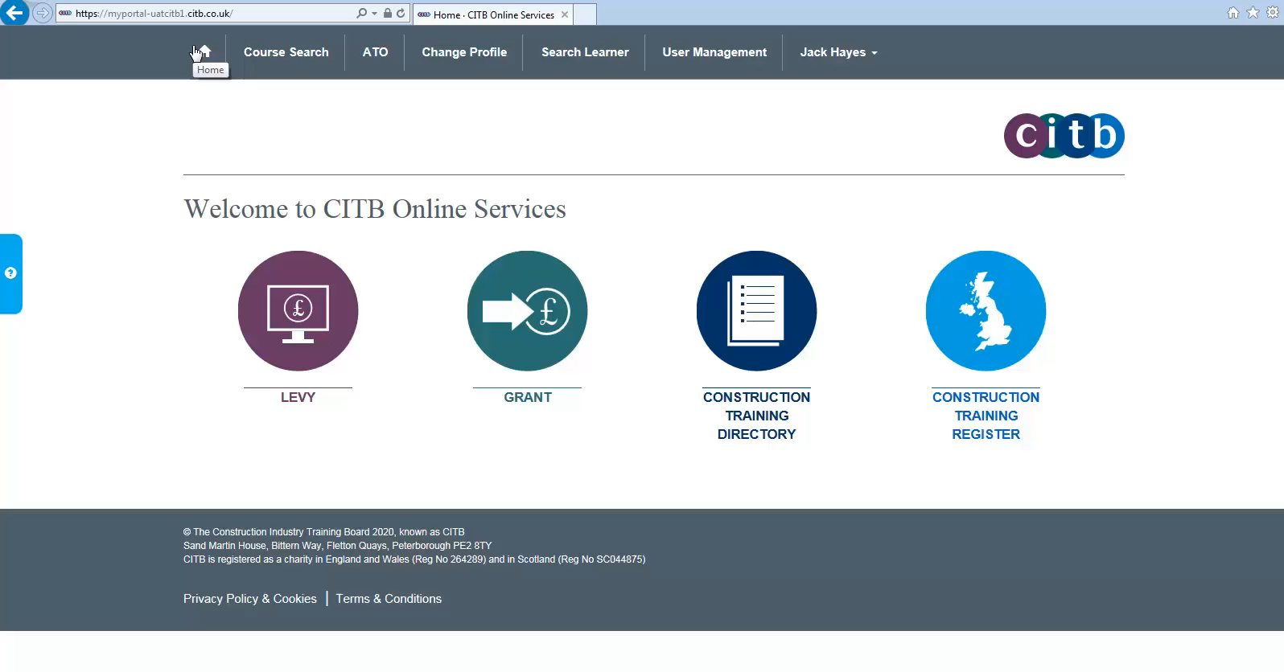

Slide 12
If you are successful, the primary contact for the ATO will receive a notification email. This may not be the same person who is adding the new products.
You will then need to sign the Forms of Agreement for those new products and wait for our countersignature. Once they have been countersigned you can advertise your courses on the Directory or apply for approval for your assured and recognised standards.
Applying to deliver new products
Notes:
If you want to add a new category of product
Click on “Apply for new products”.
You will see a list of the available product categories. Any product categories that you are already approved to deliver will be automatically checked in the tick box.
Select the product option you want and click “Submit”.
If you are delivering assured products commercially there is a £750+vat sign up charge. For all other products, they are free to access the standards.
If you are successful, the primary contact for the ATO will receive a notification email. This may not be the same person who is adding the new products.
You will then need to sign the Forms of Agreement for those new products and wait for our countersignature. Once they have been countersigned you can advertise your CITB products on the Directory or apply for approval for your assured and recognised products.

Slide 13
ATO functionality
Delivering Assured Products

Slide 14
To gain approval for your assured courses, you must submit a self-assessment for each training standard.
Only published standards will require this; some standards are still in development. You are pre-approved to deliver in development standards. Both In development and Published standards are grant eligible.
Delivering assured products
Key point
goes here:
Arial 20pt
Key point
goes here:
Arial 20pt

Slide 15
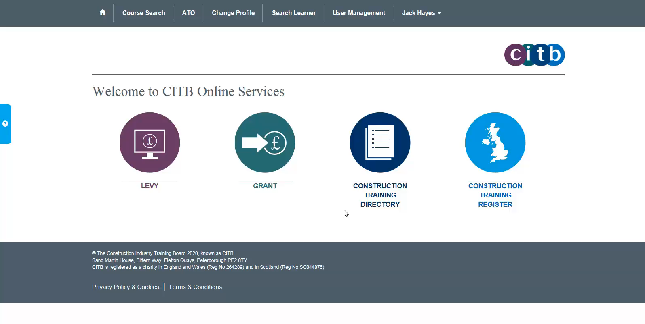

Slide 16
You can upload multiple files during the self-assessment, but each must be less than 10MB.
Please rename your files so they are easy for us to identify.
If the application is successful, the status will change to “Submission verified and successful” and we will send an email within 10 days informing the recipient that the course can now be advertised and achievements can be submitted. The Standard will also appear in your list of approved Standards.
If unsuccessful you will receive an email advising that more information is needed. The CITB quality and verification team will also have left details on your self-assessment record about what else you need to provide for approval.
Delivering assured products
Key point
goes here:
Arial 20pt
Key point
goes here:
Arial 20pt

Slide 17
ATO functionality
Delivering Recognised Products

Slide 18
To offer recognised courses, you don't need to fill in a full self-assessment, you only need to upload certification or a contract of agreement between your organisation and the awarding body.
As with Assured products you can upload multiple files to support your application, but each must be less than 10MB.
Please rename your files so they are easy for us to identify.
If successful, the status will change to “Submission verified and successful” and you will be informed by email that the courses relating to this Standard can now be advertised and achievements can be submitted. The Standard will also appear in your list of approved Standards.
If unsuccessful you will receive an email advising that more information is needed. The CITB quality and verification team will have provided feedback in the ‘Comments and Rationale’ area.
Delivering Recognised products

Slide 19
ATO functionality
Advertising courses

Slide 20
Once you have approval for your products, you can advertise them on the Construction Training Directory.
If you are currently only wishing to deliver in house training to staff non commercially then there is no need to do this step.
To advertise your products, you first need to add venues and courses to your account.
You will also have to add training schedules to your courses, giving the dates, times, locations and other important details your customers will need to know.
Advertising courses on the CTD
Key point
goes here:
Arial 20pt
Key point
goes here:
Arial 20pt

Slide 21
You can create, amend and delete venues on the portal.
Repeat the process as needed for multiple venues. The venues can be any location you are prepared to deliver the training and not just your primary location.
Venues
Notes:
it’s best to start with the postcode or Line 1 field. A list of addresses appears for you to choose from. Click on the one you want and the field boxes fill for you automatically. If there isn’t an exact match, click the closest and amend the field boxes by hand.

Slide 22
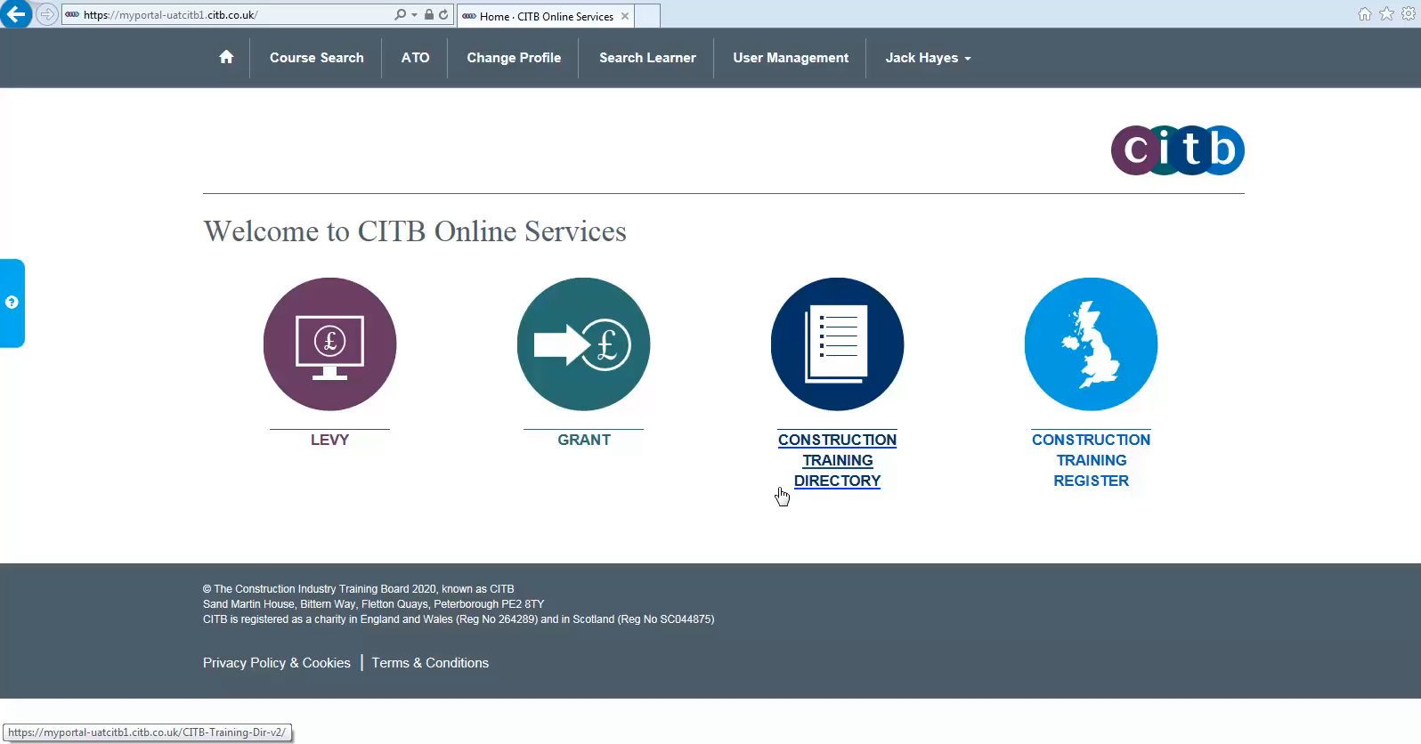

Slide 23
Next step is to add your courses
Select the standard you wish to deliver
Fill in the mandatory course details boxes, including title, duration, price and description
Adding courses
Key point
goes here:
Arial 20pt
Key point
goes here:
Arial 20pt

Slide 24


Slide 25
To add a bulk training schedule, use the template to link it to a course and venue adding dates, times, and the maximum number of attendees.
Using the template training schedules can be created, amended or deleted.
Bulk Training schedules
Key point
goes here:
Arial 20pt
Key point
goes here:
Arial 20pt
Notes:
If you no longer want a course to appear in the Directory, you can unpublish the training schedule. This will remove it from search results. The course will still be saved in your account, so that you can publish it again later.

Slide 26
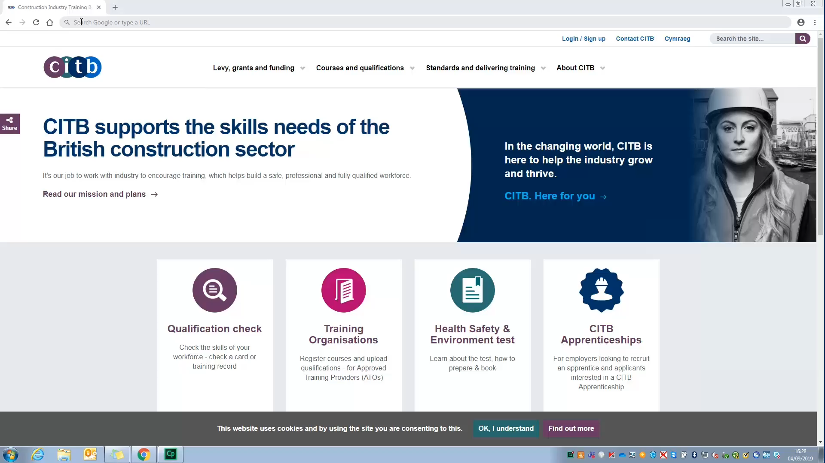

Slide 27
ATO functionality
Submitting Achievements

Slide 28
ATOs are required to upload learners’ achievements to the Construction Training Register within 10 days of achievement of a course.
ATO’s must capture the Companies CITB Levy registration number to enable automatic grant payment. ATO’s are encouraged to ask employers to provide this on booking the course.
The Fair Processing Notice should be shared with learners outlining how their details will be used.
You can upload achievements individually or in bulk.
Note: SSP Achievements do not need to be submitted to the Construction Training Register as you will already notify CITB through the SSP team. The SSP team then populates the CTR on your behalf.
Submitting Achievements

Slide 29
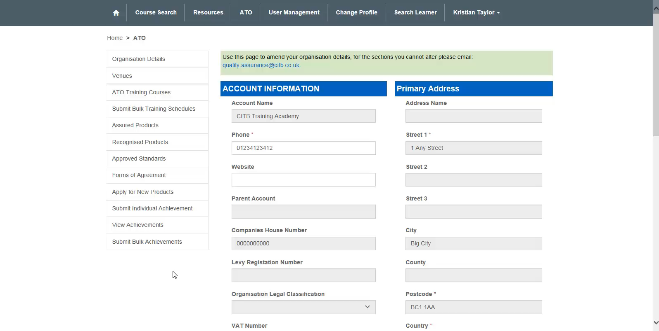
Notes:
Important to ensure that the employer registration number is correct.
Tick the relevant box if the employee is employed by a different employer from the one receiving the grant. Failure to do so may mean that the grant payment is paid to the wrong employer.

Slide 30
In the template, above each columns you will see guidance notes about the information required.
• Mandatory fields are highlighted in blue.
• Yellow fields require at least 1 section to be completed.
• Notes column is optional and can be used to add information that will be replicated on the employer grant payment. This would usually be a purchase order or something similar.
To upload an achievement via bulk you will need to supply the following information:
• name
• date of birth
• home address and postcode
• National Insurance Number or Individual ID/Registration number
• employer registration number (if a grant is to be paid)
• completed course title/ GET code
• course achievement date
To make this process easier, the ATOs can create a spreadsheet for the employers to complete on booking with all the required information, which would then be ready to copy and paste into the template for submission.
Uploading Bulk achievements
Key point
goes here:
Arial 20pt
Key point
goes here:
Arial 20pt

Slide 31
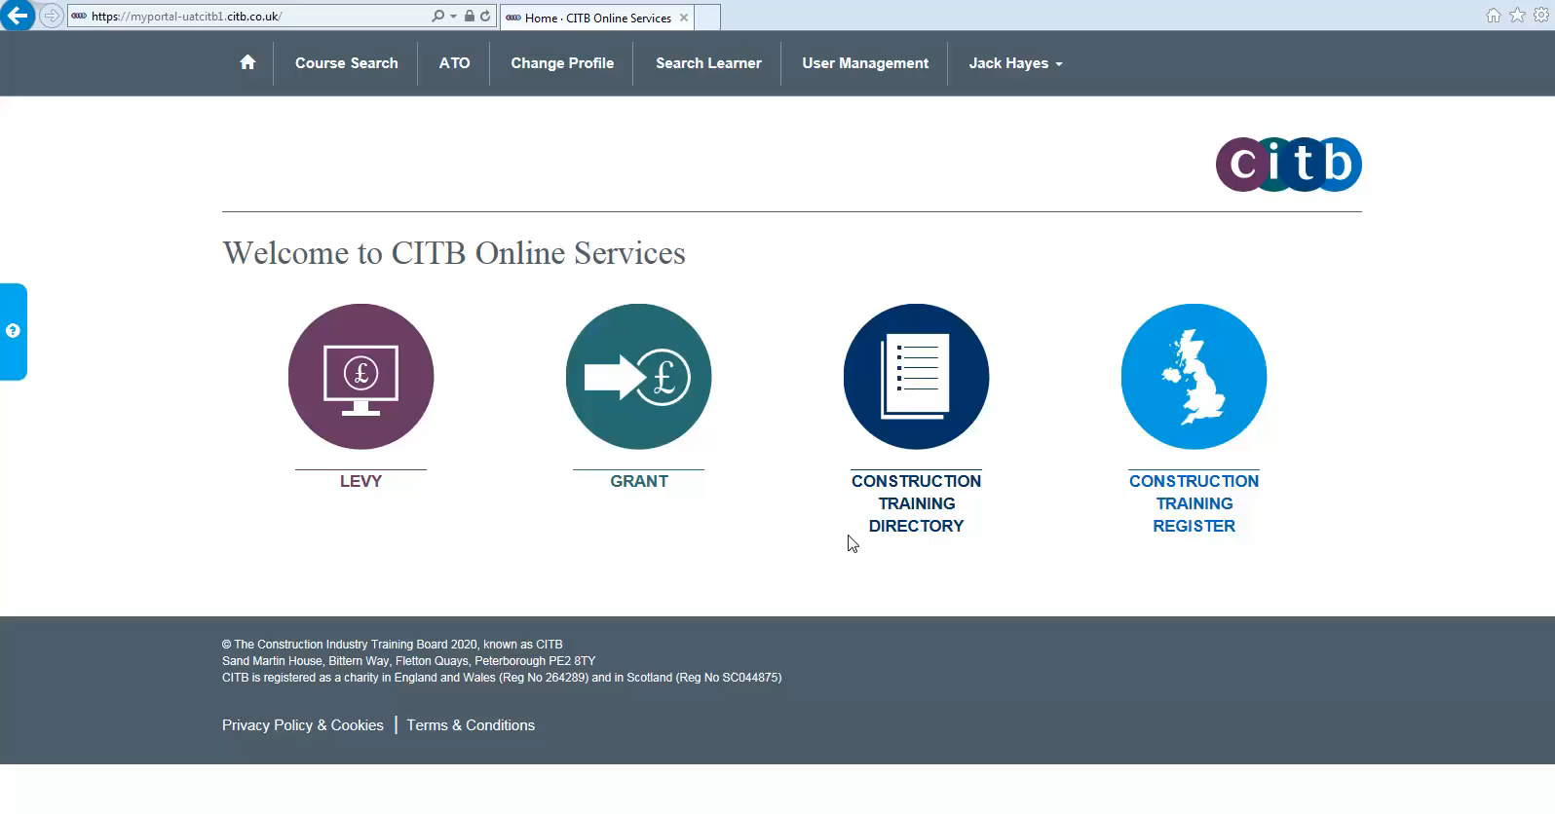
Uploading Bulk achievements
Key point
goes here:
Arial 20pt
Key point
goes here:
Arial 20pt

Slide 32
Once you submit an achievement you have 48 hours to edit or delete it before it is processed.
After 48 hours, you will not be able to make any amendments without contacting CTDServices@citb.co.uk
Amending achievements

Slide 33
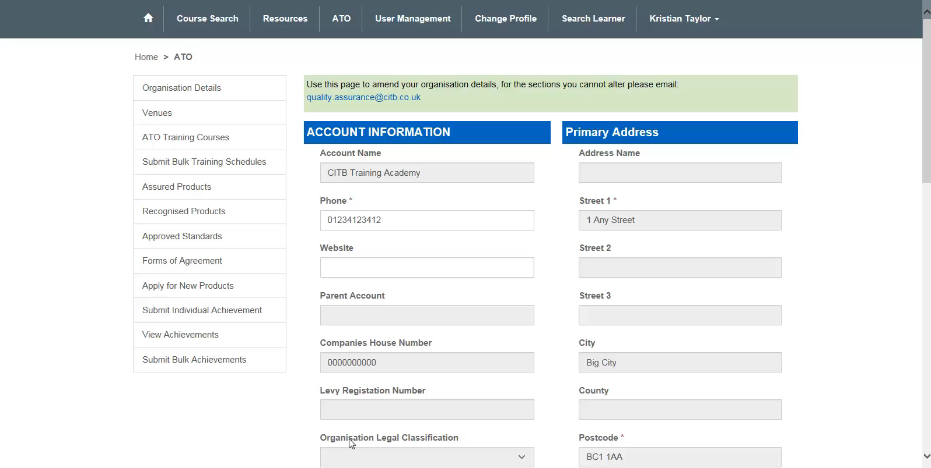

Slide 34
ATO functionality
Managing account

Slide 35
The person who first set up the ATO account is a Super User, with full administration rights within the portal.
A super user can add other users and amend existing users to perform certain functions. They can do this on the User Management page.
The options available are:
• ATO Remove Access – to remove access to the portal for the user
• ATO Super User - full administration rights (max of 4 per ATO)
• ATO User – can add venues and courses and publish them, but only view other pages
• ATO Bespoke – Custom mix of permissions for functionality
When a Super User adds another user an invitation email will be sent to the new contact, inviting them to log in to the portal.
Managing your account
Key point
goes here:
Arial 20pt
Key point
goes here:
Arial 20pt

Slide 36


Slide 37
Clicking the ATO button takes you to the organisation details page, here you can update any of the fields that are not greyed out.
Contact ctdservices@citb.co.uk to update any greyed-out fields.
Updating organisation details
Key point
goes here:
Arial 20pt
Key point
goes here:
Arial 20pt

Slide 38
If you are a user for more than one organisation in the portal – for example an ATO that is also a grant-claiming employer – you may need to change your profile in the portal.
This is done by clicking the "Change profile" button at the top of the page.
For grant-claiming employers, the profile can be identified by the seven digit CITB Levy registration number.
Changing Profiles
Key point
goes here:
Arial 20pt
Key point
goes here:
Arial 20pt

Slide 39
User guides - resources area of portal
TM trouble shooter we will send out with the presentation
Ctdservices@citb.co.uk - First step for employers or ATOs to get help.
Levy.grant@citb.co.uk - Any queries relating to levy returns, grant payments or reports
Levygrant.online@citb.co.uk - For employers who are having issues logging in
Quality.assurance@citb.co.uk - Any issue relating to Self assessments or organisation details.
Training model trouble shooter https://forms.office.com/r/zJwnibUH3b
The training model is fully GDPR compliant. Upon sign up ATOs are given a copy of our Standard Terms, with Annex A of the standard terms explicitly outlining what information is required and why. Any queries relating to GDPR should be directed to the Standard Terms and annex A of the ATO agreement which fully outlines the roles and responsibilities.
Your local CITB advisor will also be able to support you offering advice and guidance around the portal. They also have access work instructions and explainer videos are available to you.
Resources available
Key point
goes here:
Arial 20pt
Key point
goes here:
Arial 20pt

