Slide 1





LESSON 3
common spaces

Slide 2



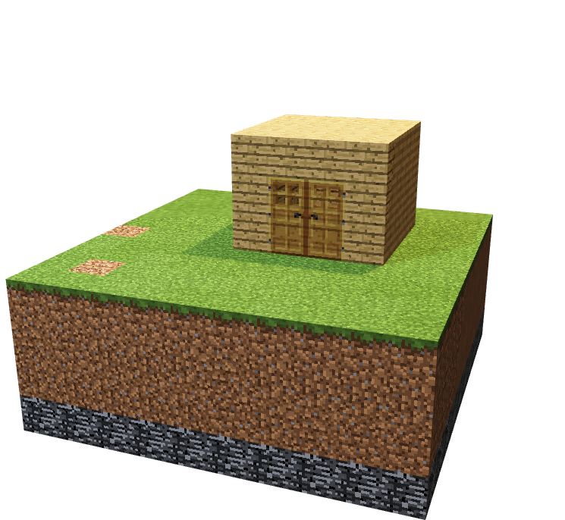
To get familiar with gameplay and features of Minecraft
To construct basic buildings and use various inventory tools and items

Slide 3

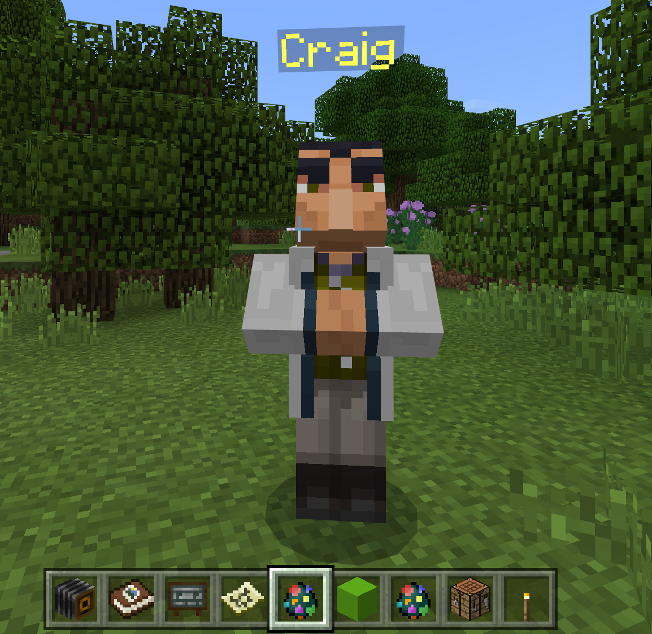
Urbanisation
Private Spaces
Common Space
Public Space
Multifunctional
Exterior
Look for Craig to get the definition!
Notes:
Teachers – You can change this screen shot to align with your NPC. ☺

Slide 4
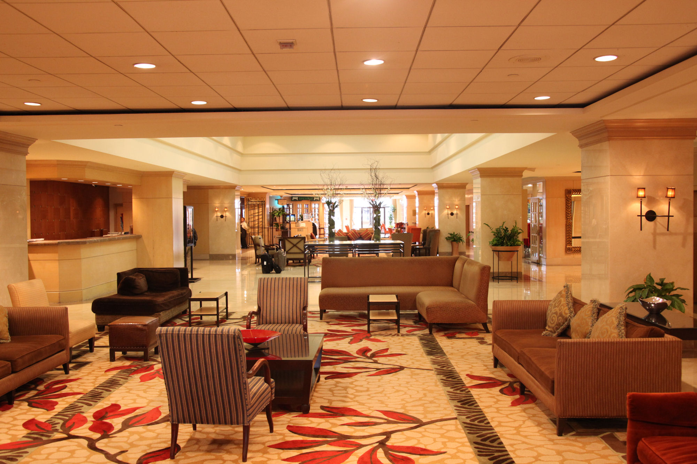
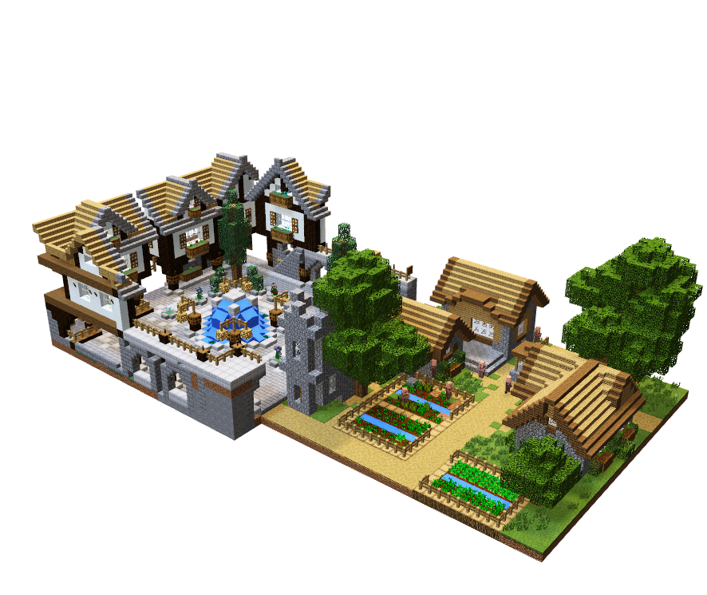
Common Spaces
Notes:
What is the difference between a private and common space? What features define a common space? Can a building contain private and common spaces?

Slide 5


Sticky Note Challenge
One positive feature you like about your design from yesterday. (must use a Minecraft term)
One thing you would add. (NOT take away; use Minecraft term)

Slide 6


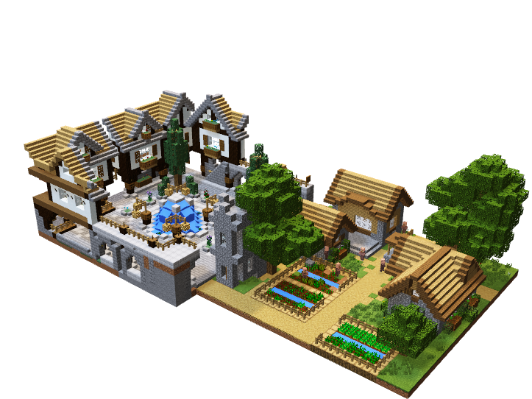
Design challenge
Round 1
Common Space
Round 2
paths

Slide 7

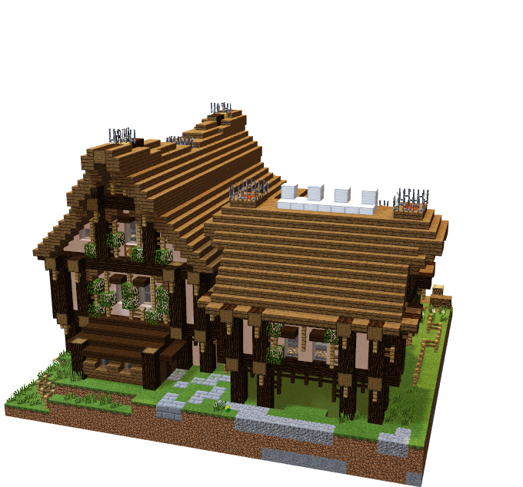
use your designs#
Construct your building based on the agreed design
Be aware of time!

Slide 8

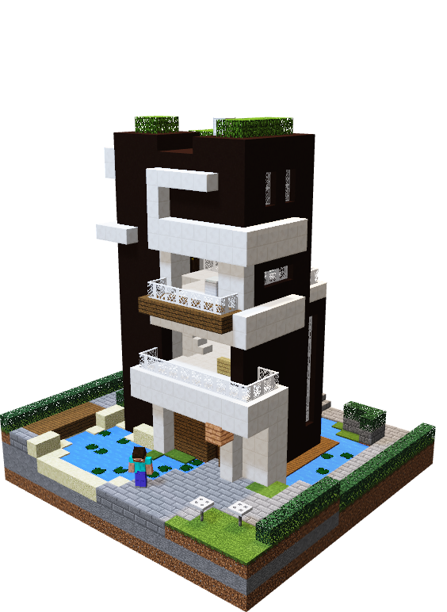
Add a suggestion from the sticky note challenge
Add detail
Add a board to name your common area
Be aware of time!

Slide 9

BE PREPARED TO ANSWER THE FOLLOWING QUESTIONS AS A TEAM AT THE END OF YOUR BUILD:
What have we built??
What makes it a private space??
Did you follow your plan??
How did you perform together as a team? (1 -10)?

Slide 10


WHAT CAN WE TAKE AWAY FROM TODAY?
What areas are left to add to our build?
Where will it be placed?
Can a single building have private, common and public spaces?
What new role will you take on next lesson?

Slide 11

Day 3

Slide 12






Go Construct - Educate Consortium led by Bouygues UK

